Slide 1
How to Make an Eagle
Mohansic Lake - FDR State Park Yorktown, NY - October 2018 to August 2019
October 28 to December 28, 2018:
Return to Mohansic Lake (7 photos)
January 3 to February 17, 2019:
Love Birds (14 photos)
February 26 to April 12, 2019:
Sitting on the Eggs (22 photos)
April 15 to April 30, 2019:
Down-covered Baby Eaglets (16 photos)
May 2 to May 29, 2019:
The Eaglets Grow and Develop (13 photos)
June 1 to August 1, 2019:
The Eaglets Learn to Fly (23 photos)

Slide 2
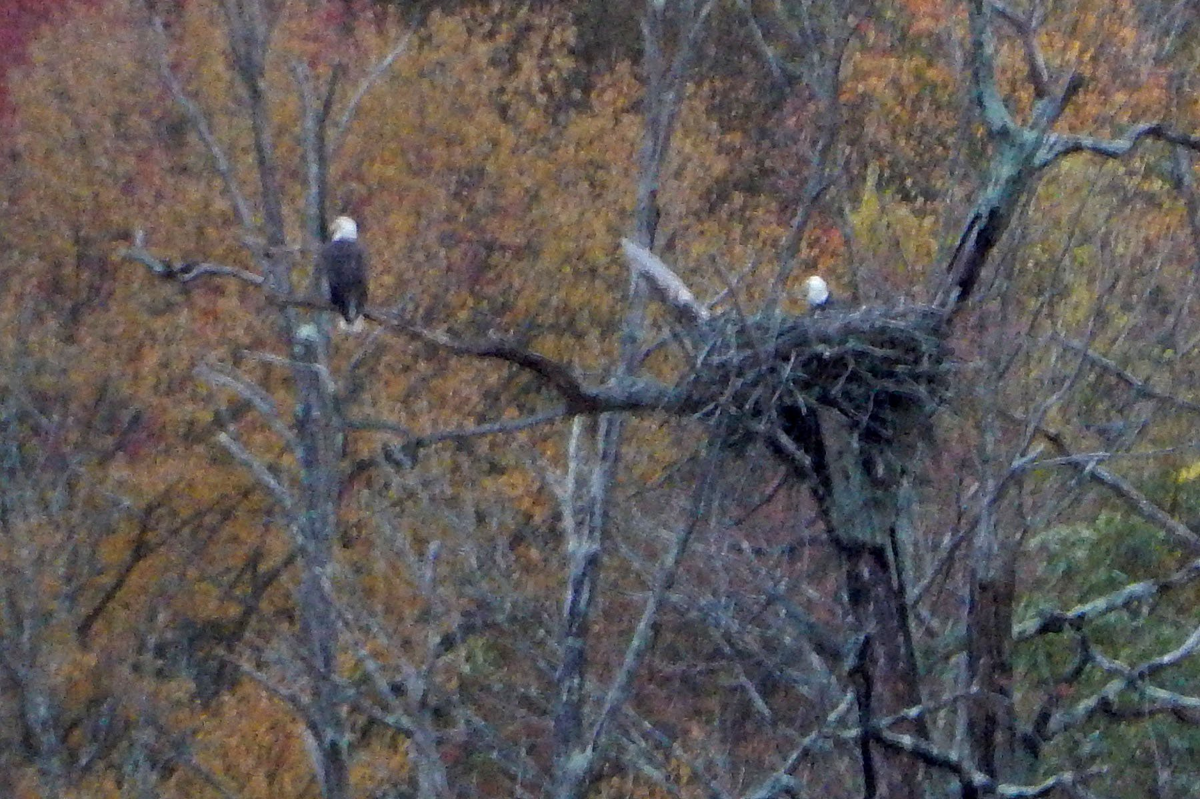
October 28, 2018:
Two Adult Eagles Arrive in FDR State Park

Slide 3
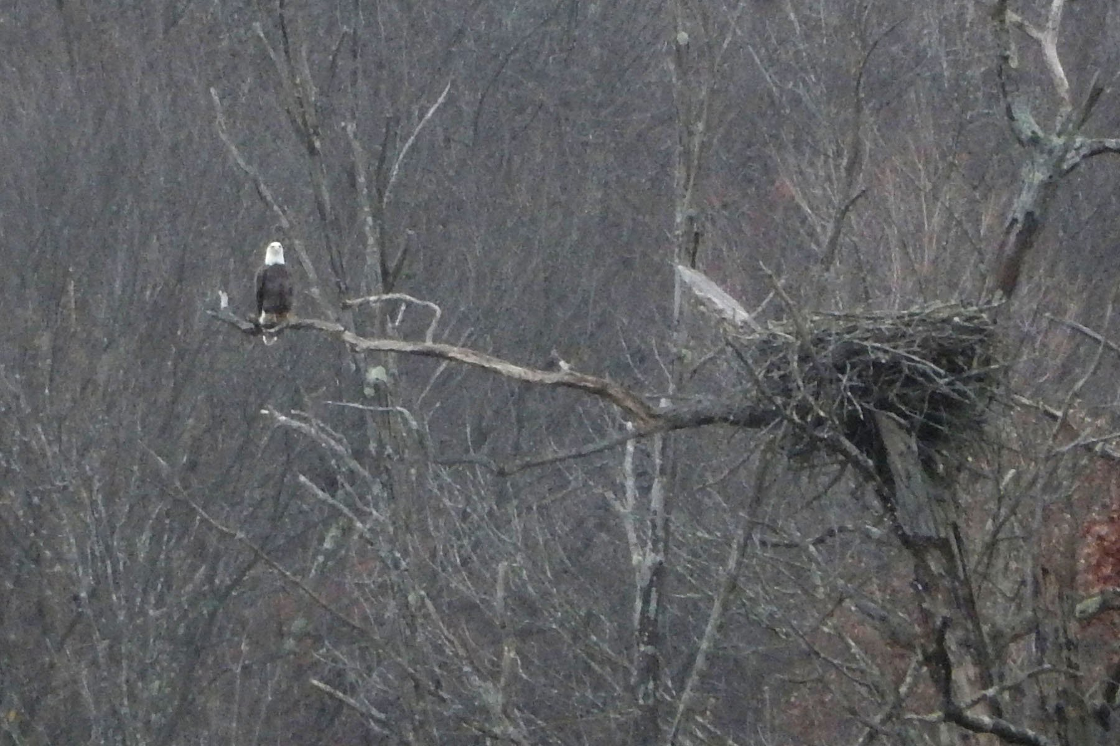
November 12, 2018: One Adult Eagle Near the Nest

Slide 4
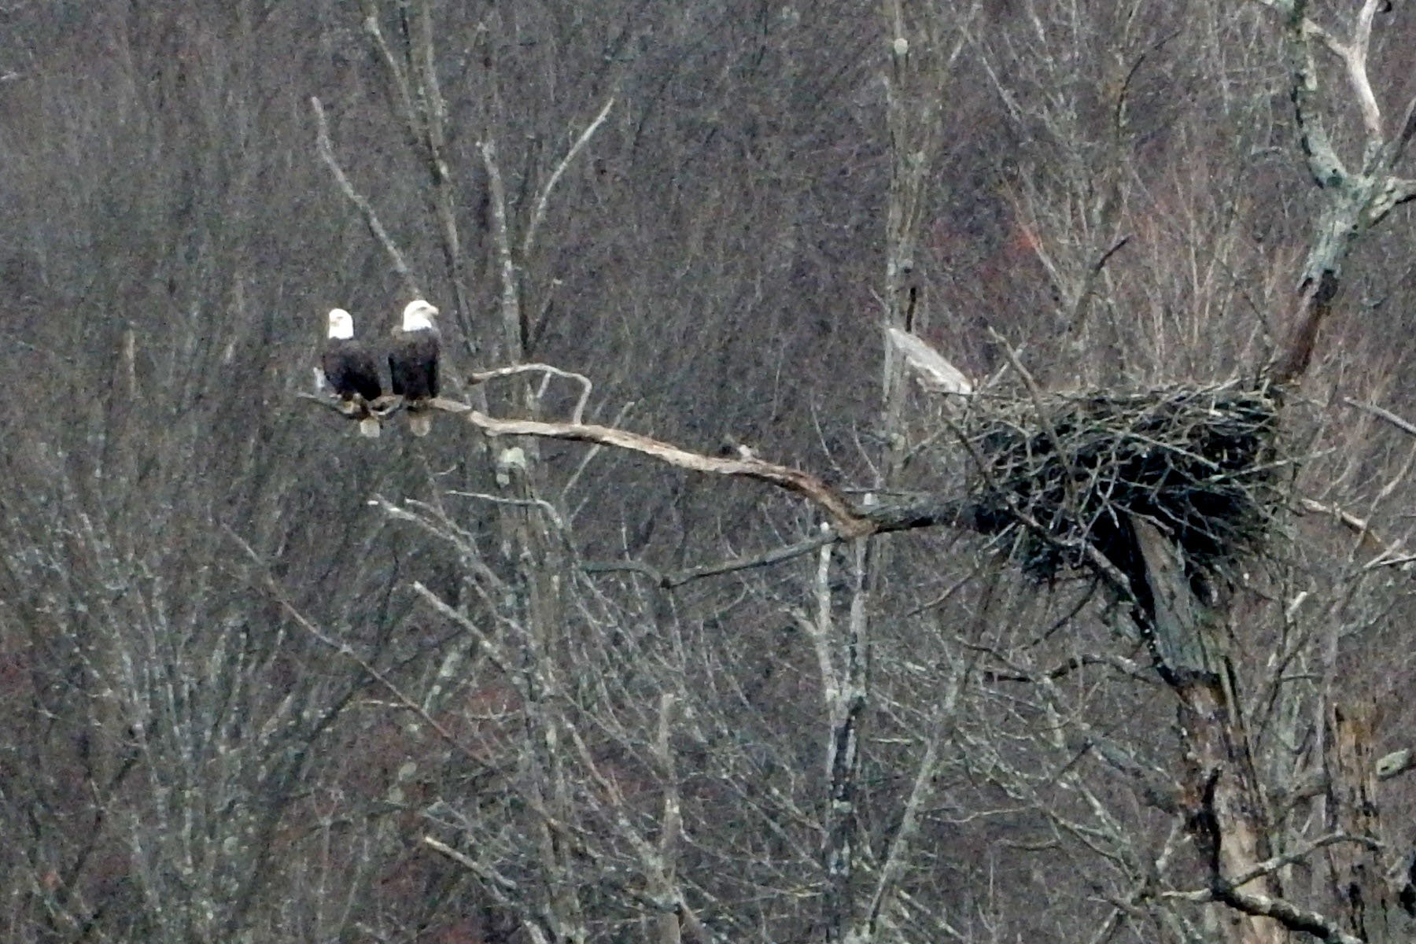
December 9, 2018: Love Birds

Slide 5
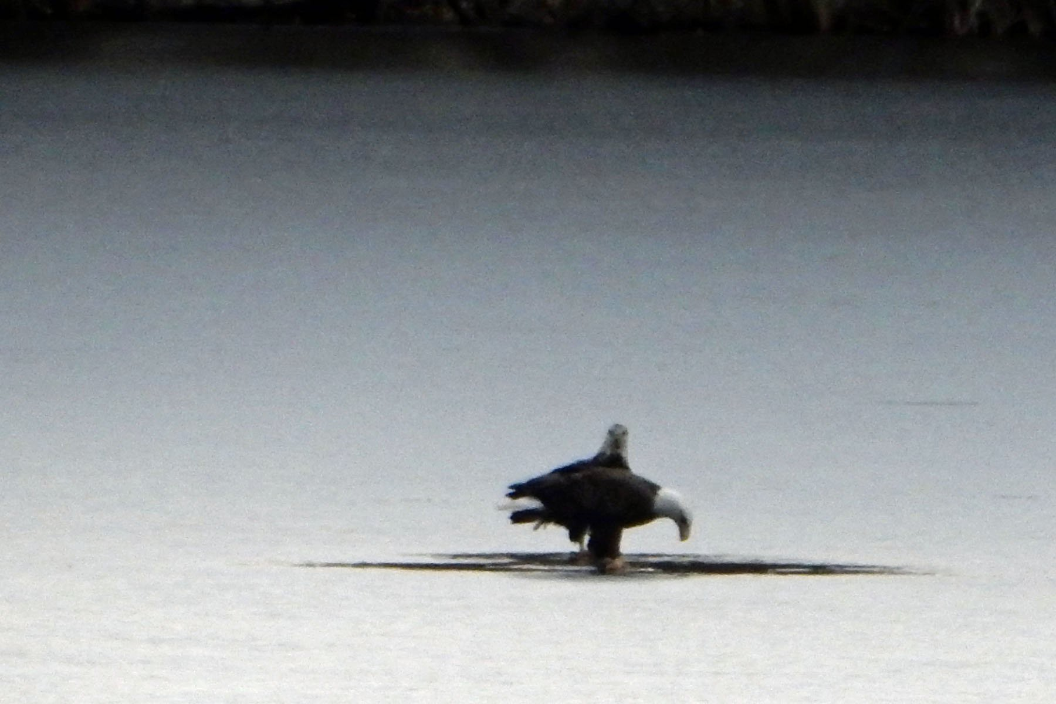
December 17, 2018 (2:55 PM):
Frozen Mohansic Lake 1

Slide 6
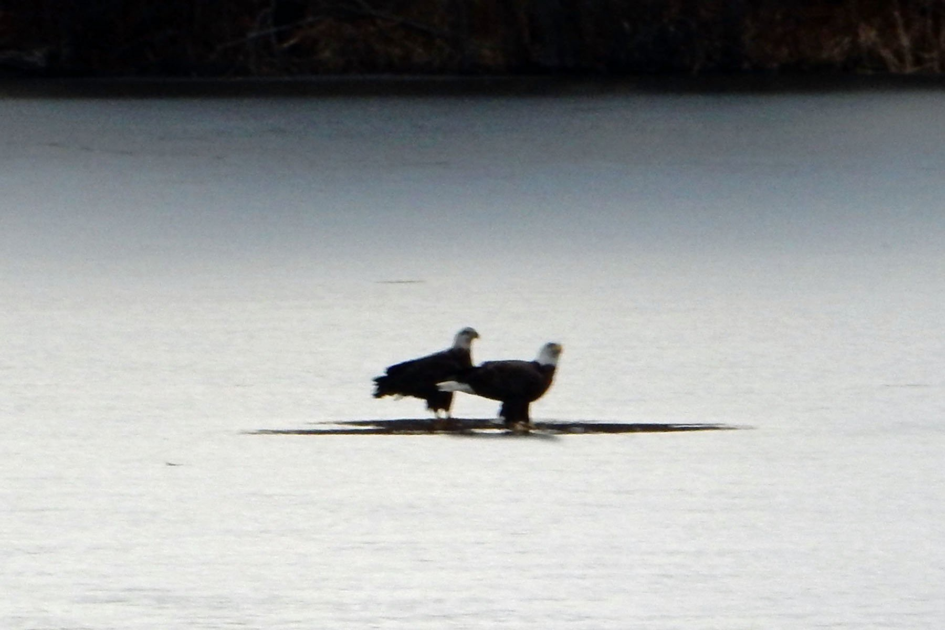
December 17, 2018 (2:56 PM):
Frozen Mohansic Lake 2

Slide 7
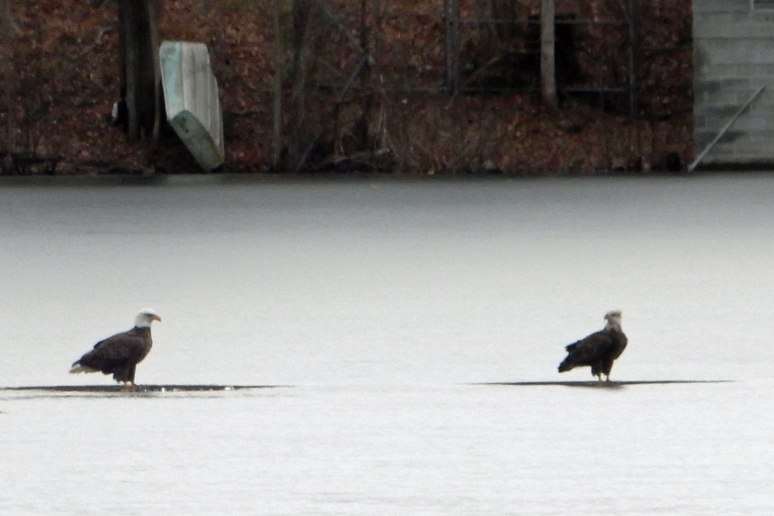
December 17, 2018 (2:57 PM):
Frozen Mohansic Lake 3

Slide 8
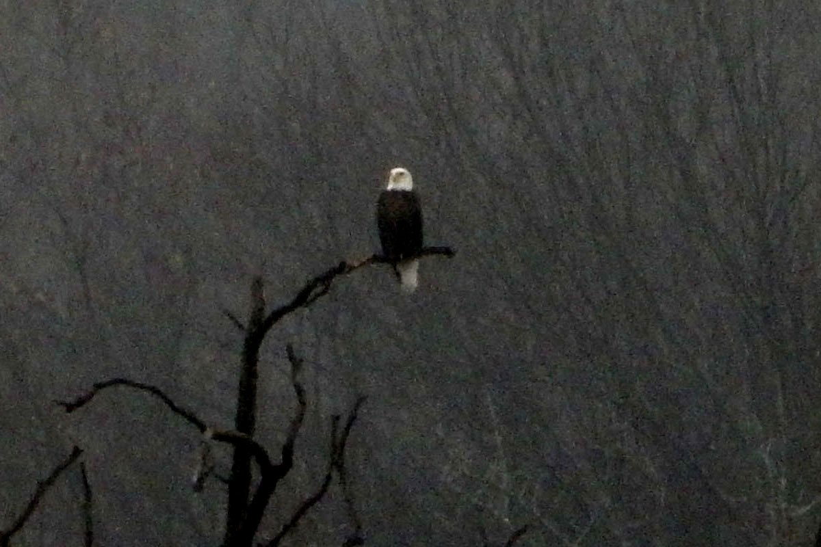
December 28, 2018: Eagle on a Perch

Slide 9
How to Make an Eagle
Mohansic Lake - FDR State Park Yorktown, NY
January 3 to February 17, 2019:
Love Birds (14 photos)

Slide 10
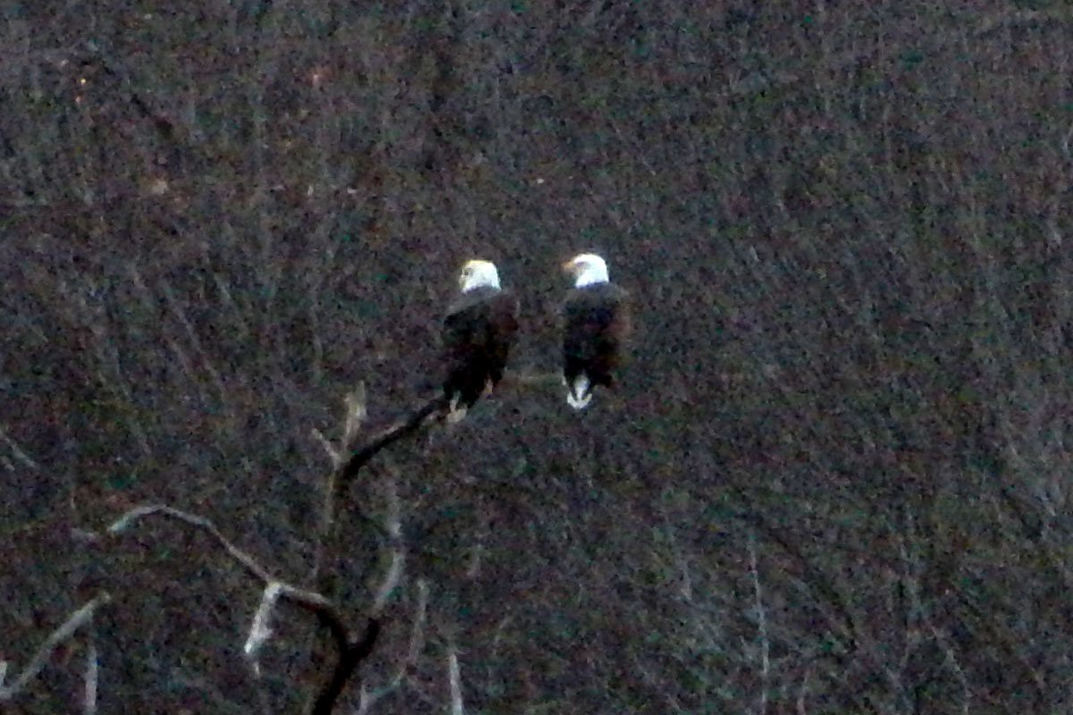
January 3, 2019: Love Birds

Slide 11
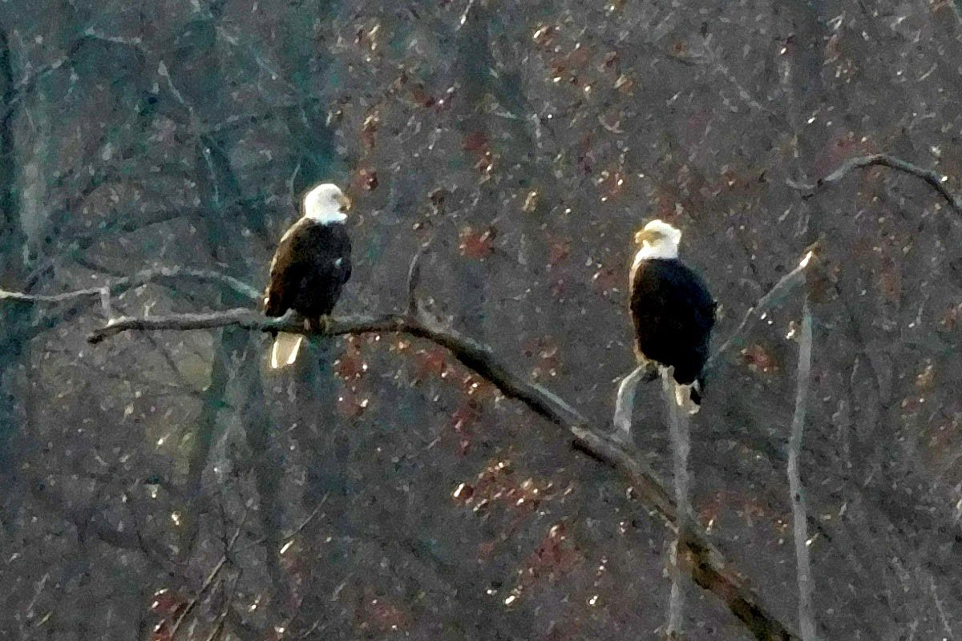
January 15, 2019: Love Birds

Slide 12
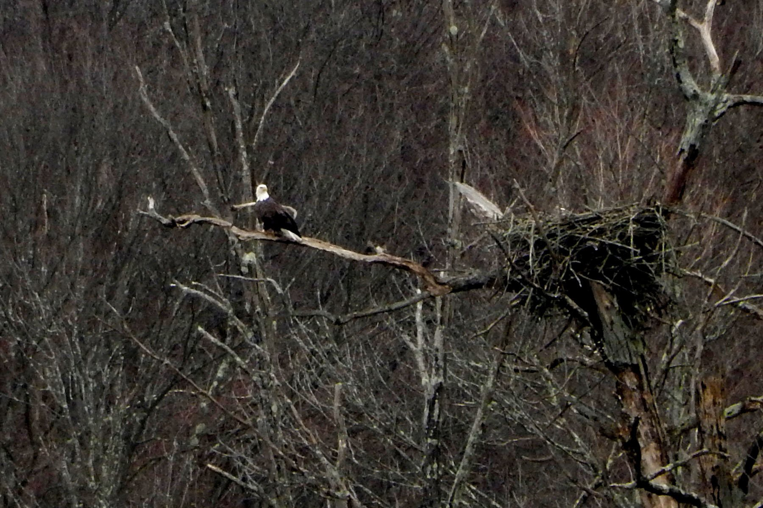
January 19, 2019 (2:45 PM):
One Adult Eagle Near the Nest

Slide 13
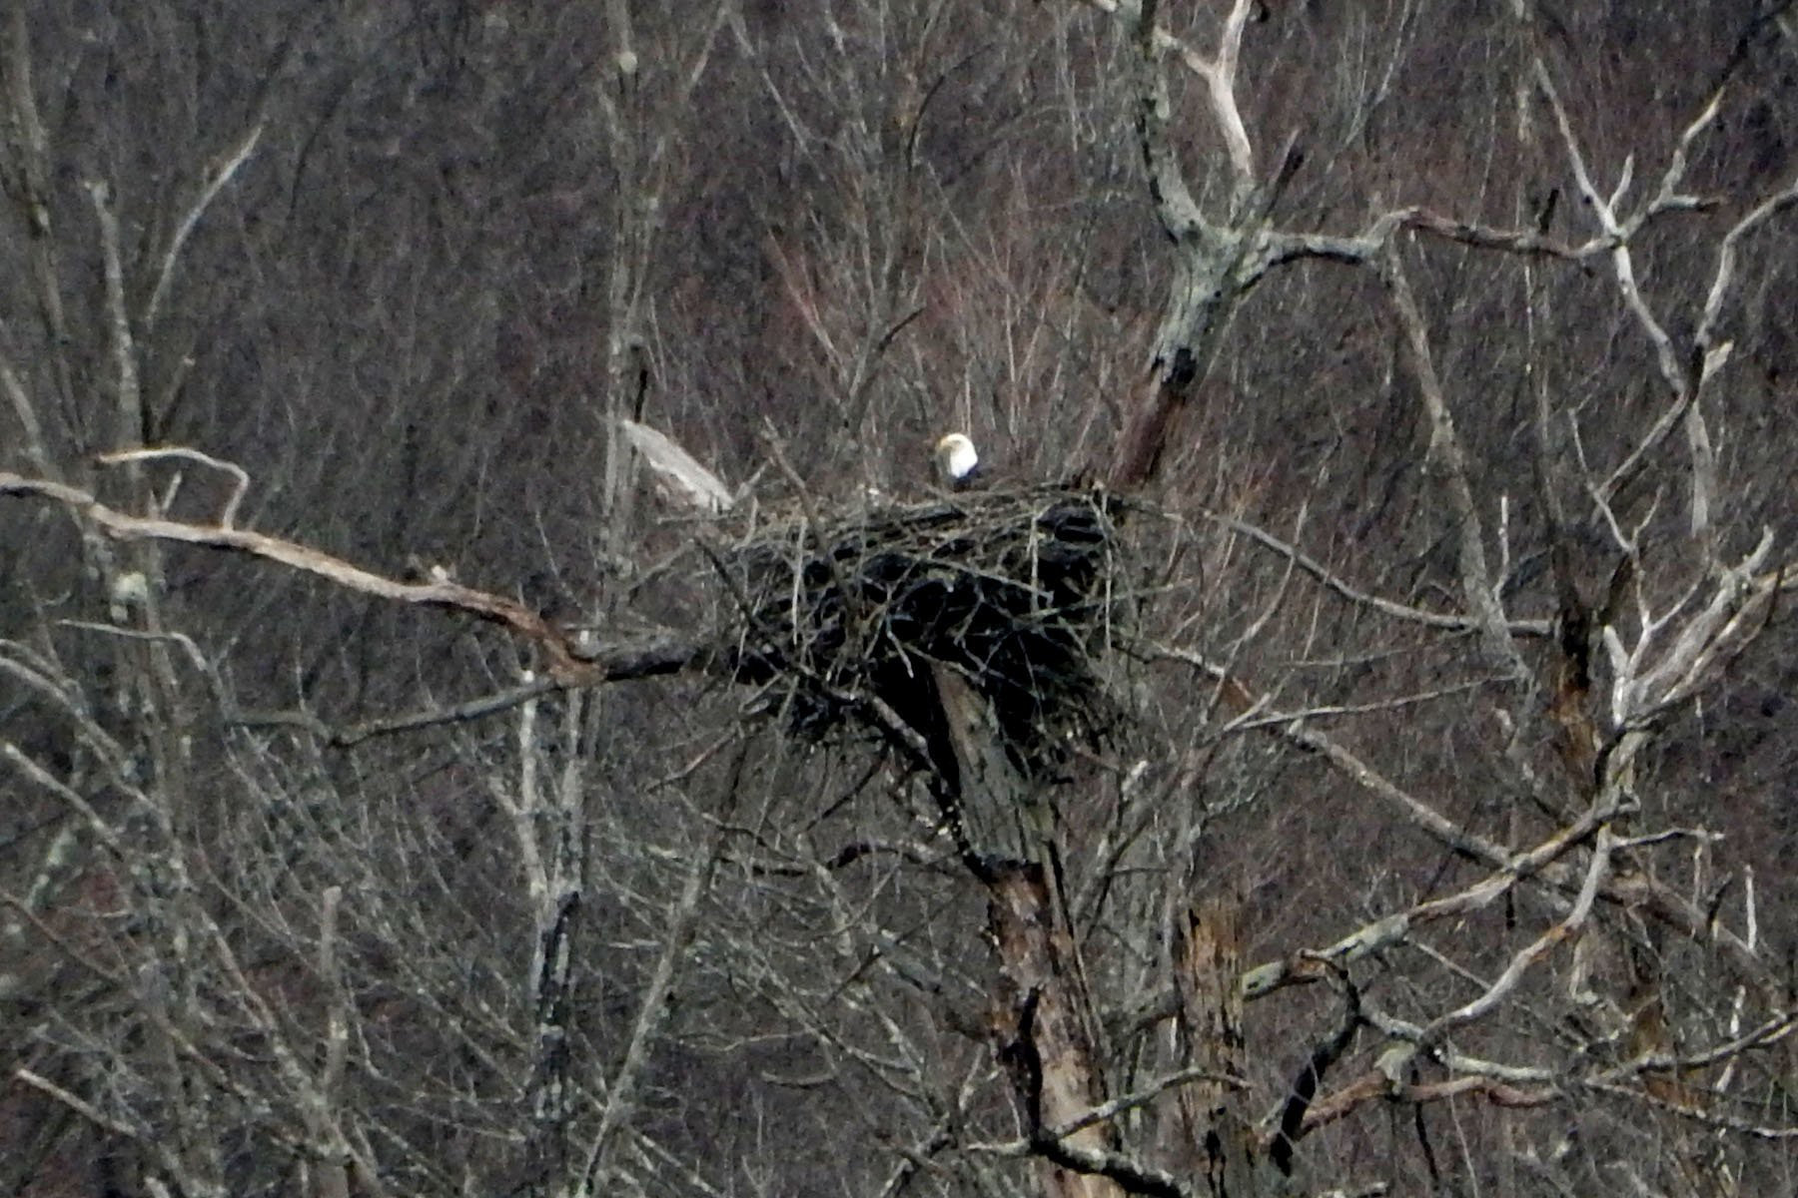
January 19, 2019 (2:46 PM):
One Adult Eagle in the Nest

Slide 14
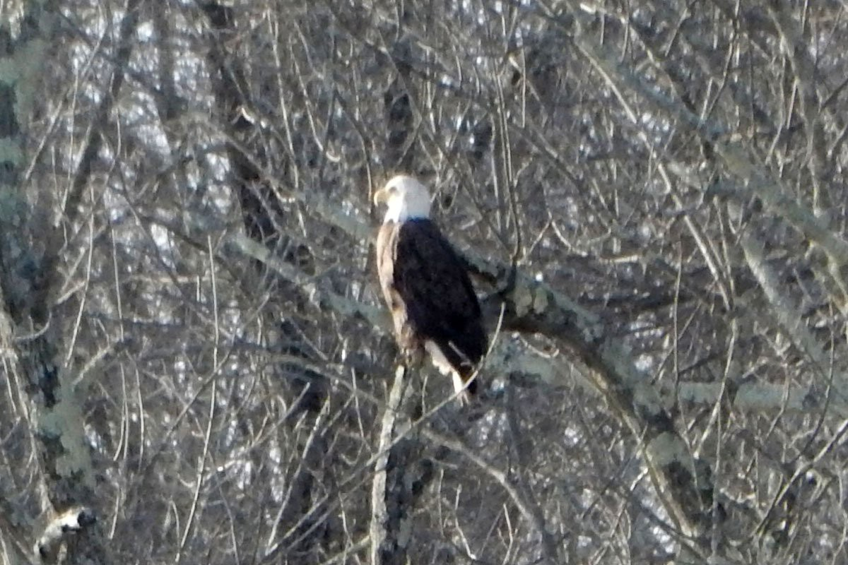
January 22, 2019:
One Adult Eagle on the Near Side of Mohansic Lake

Slide 15
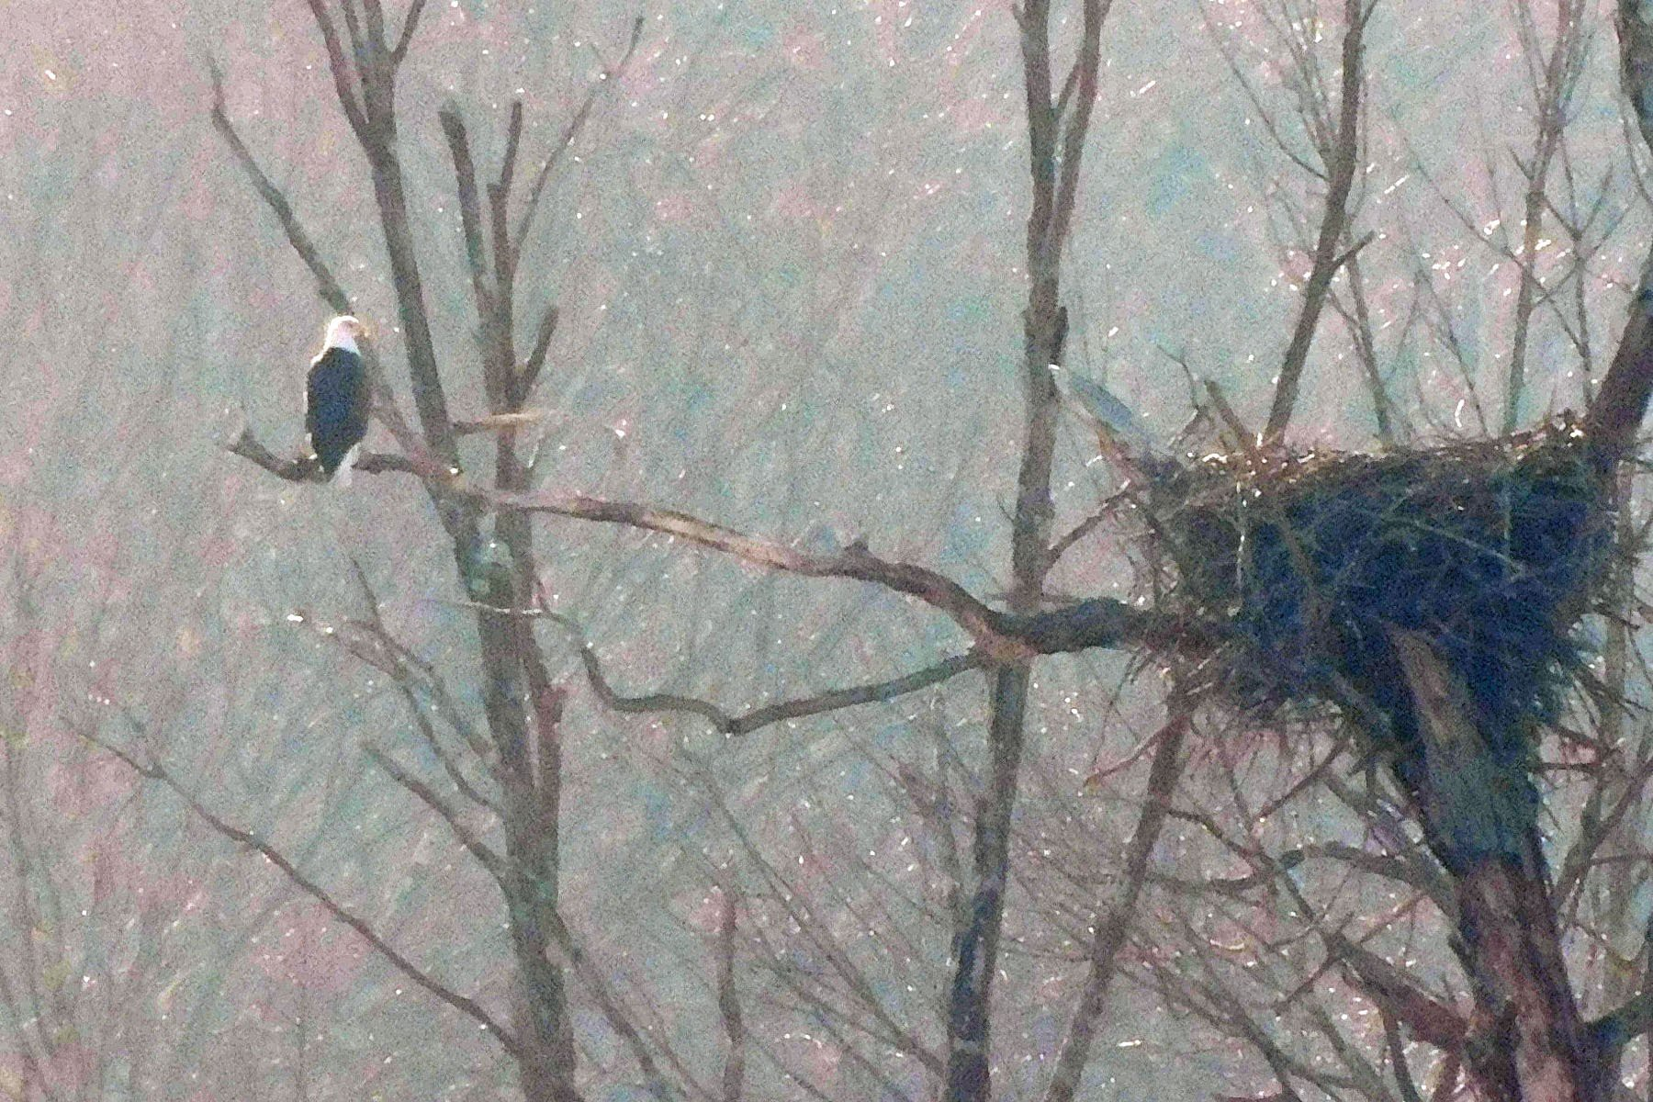
February 3, 2019:
One Adult Eagle Near the Nest

Slide 16
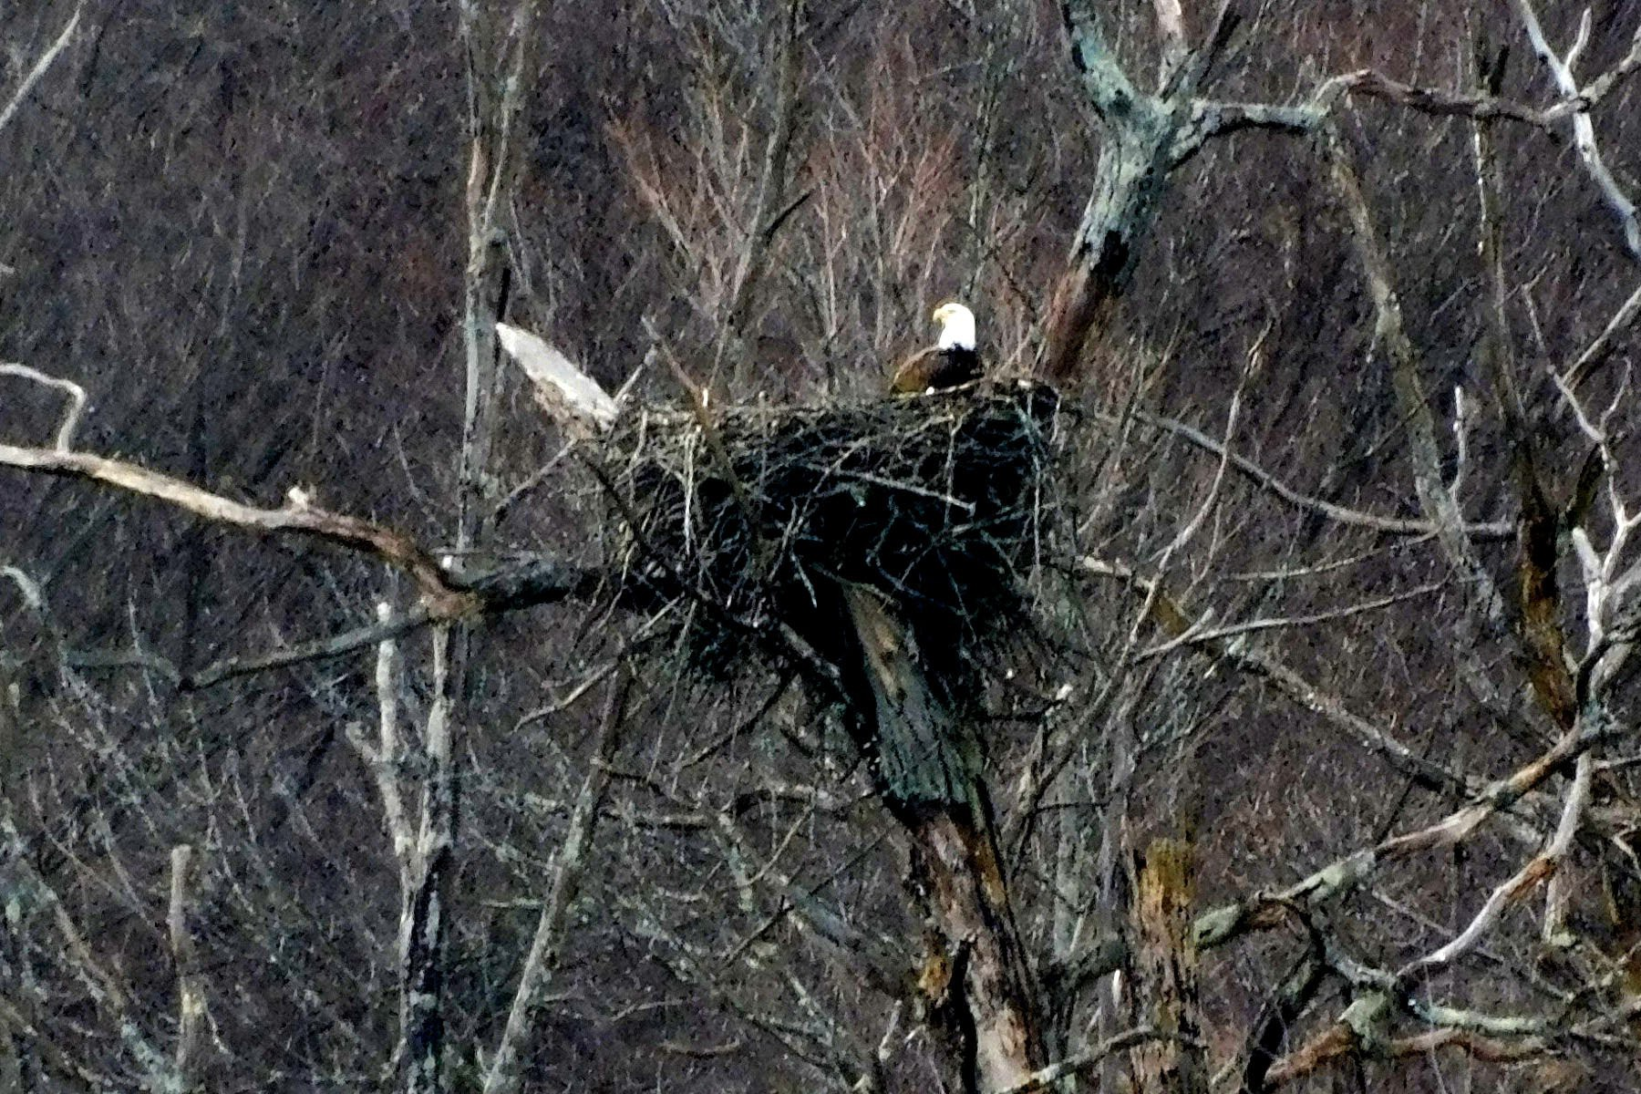
February 6, 2019: One Adult Eagle in the Nest

Slide 17
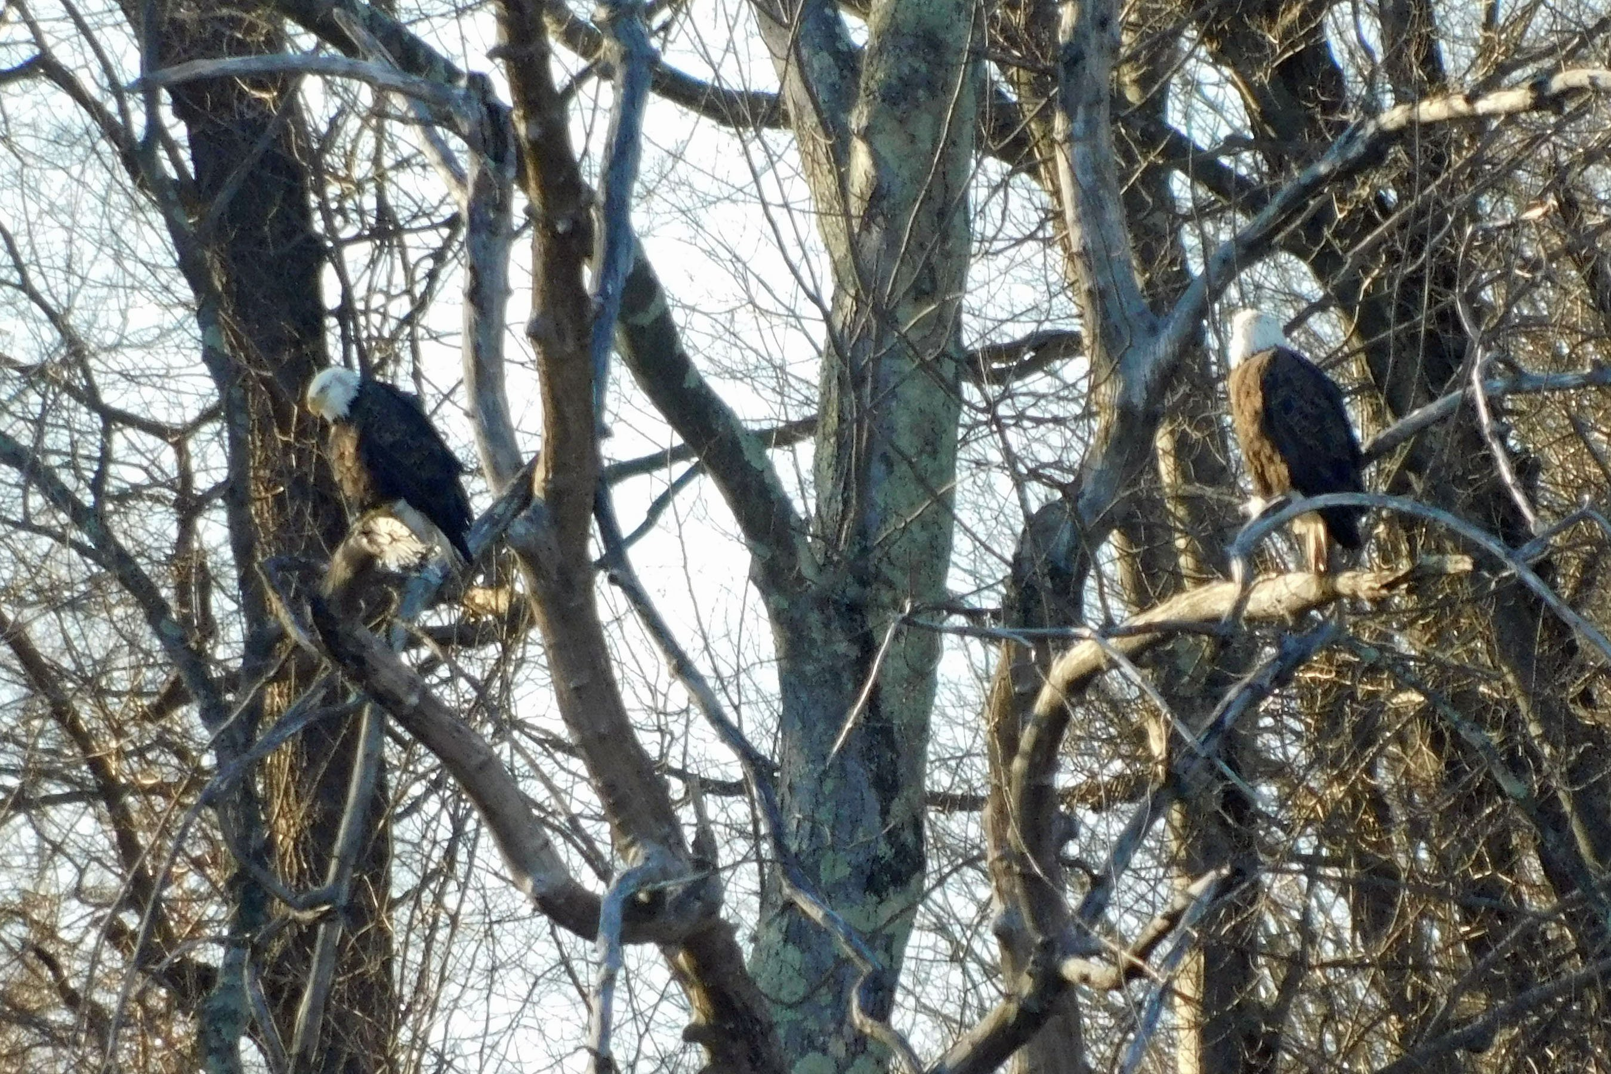
February 9, 2019 (4:03 PM): Two Adult Eagles on the Near Side of Mohansic Lake

Slide 18
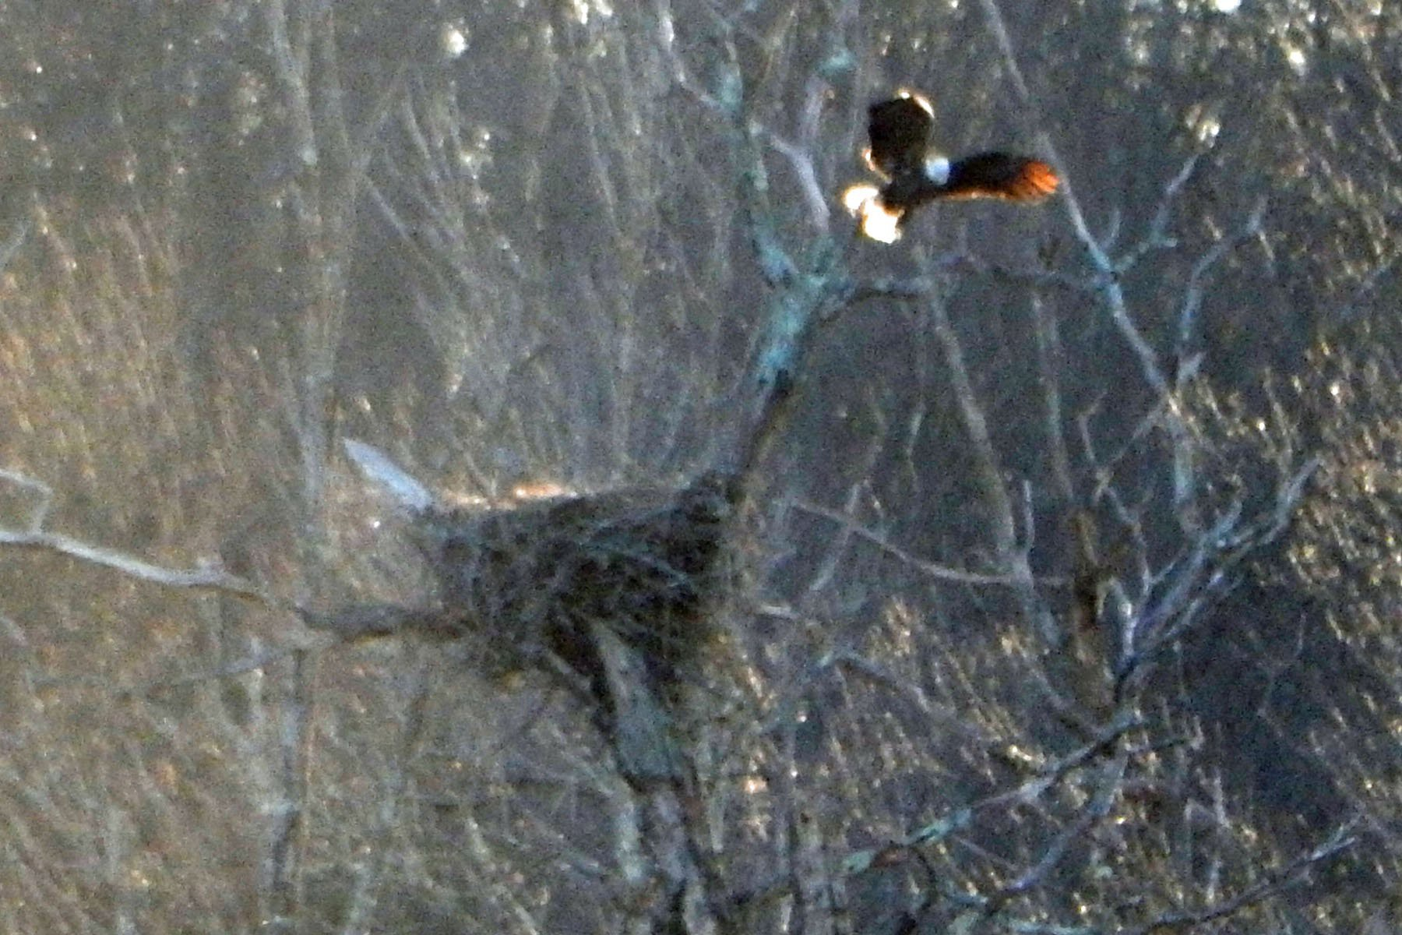
February 9, 2019 (4:39 PM):
One Adult Eagle Leaves the Nest

Slide 19
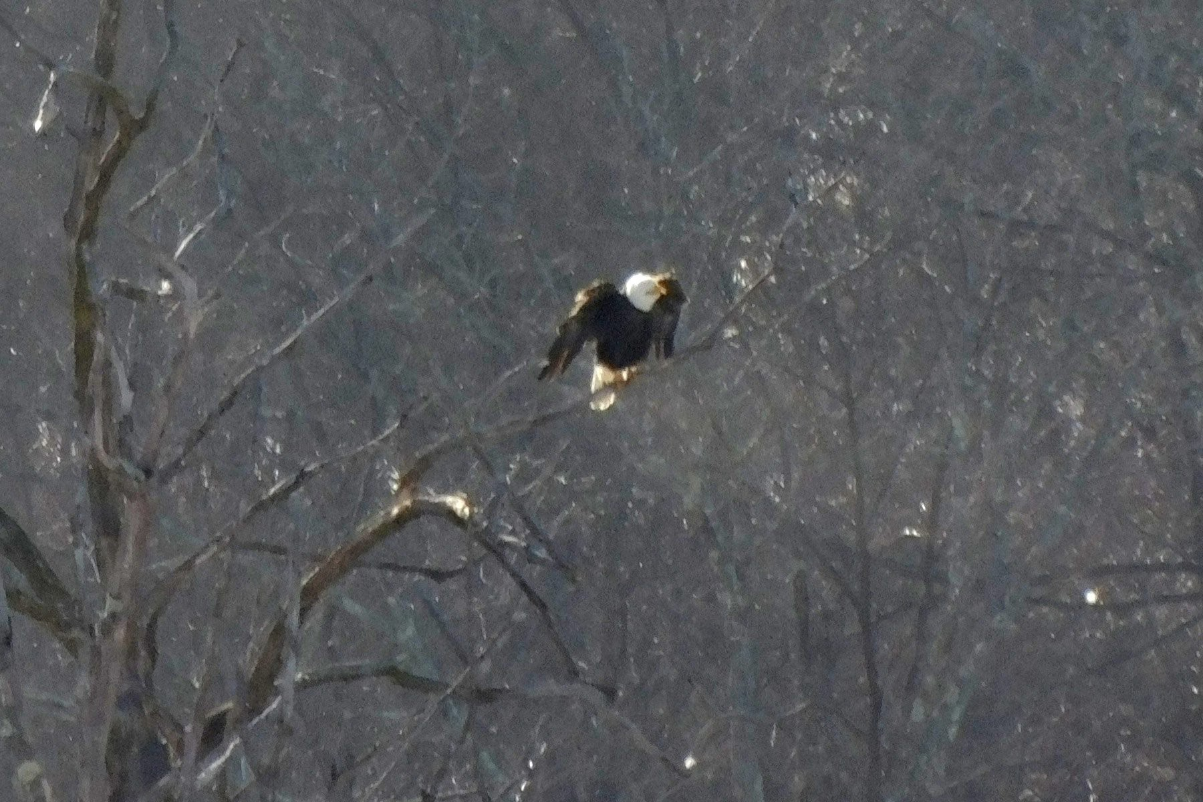
February 15, 2019: One Adult Eagle Landing

Slide 20
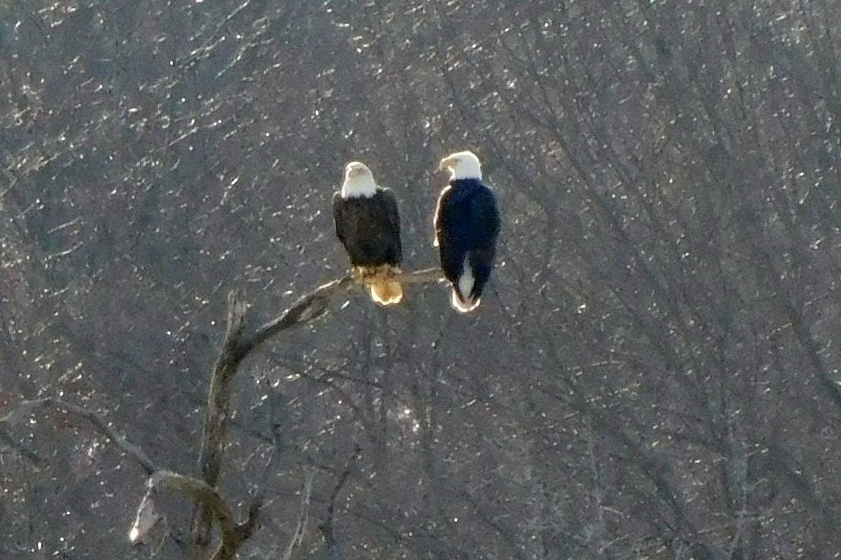
February 17, 2019 (3:17 PM): Love Birds 1

Slide 21
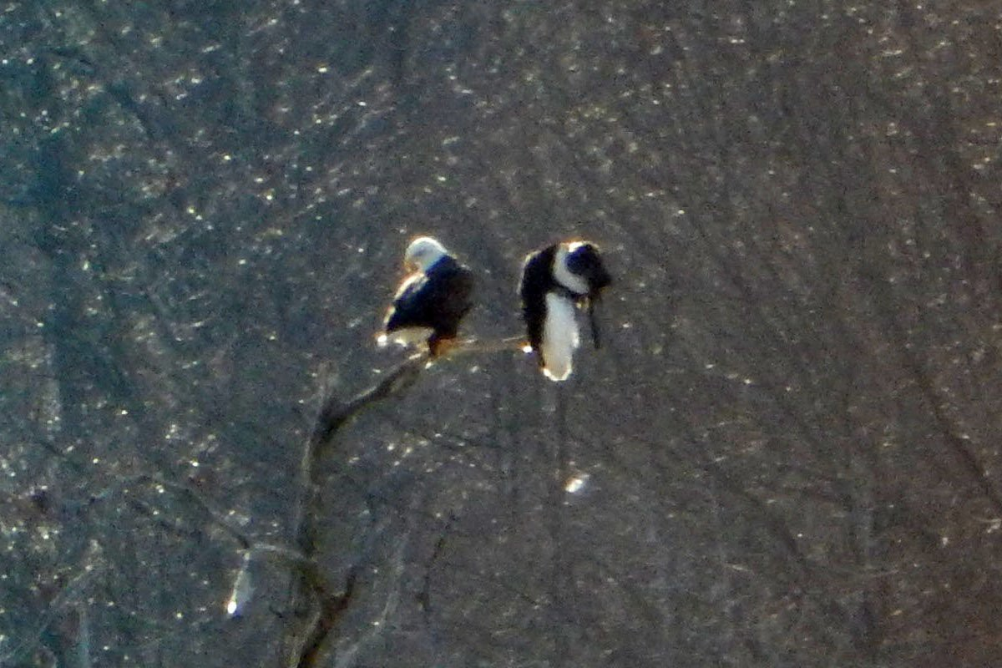
February 17, 2019 (3:19 PM): Love Birds 2

Slide 22
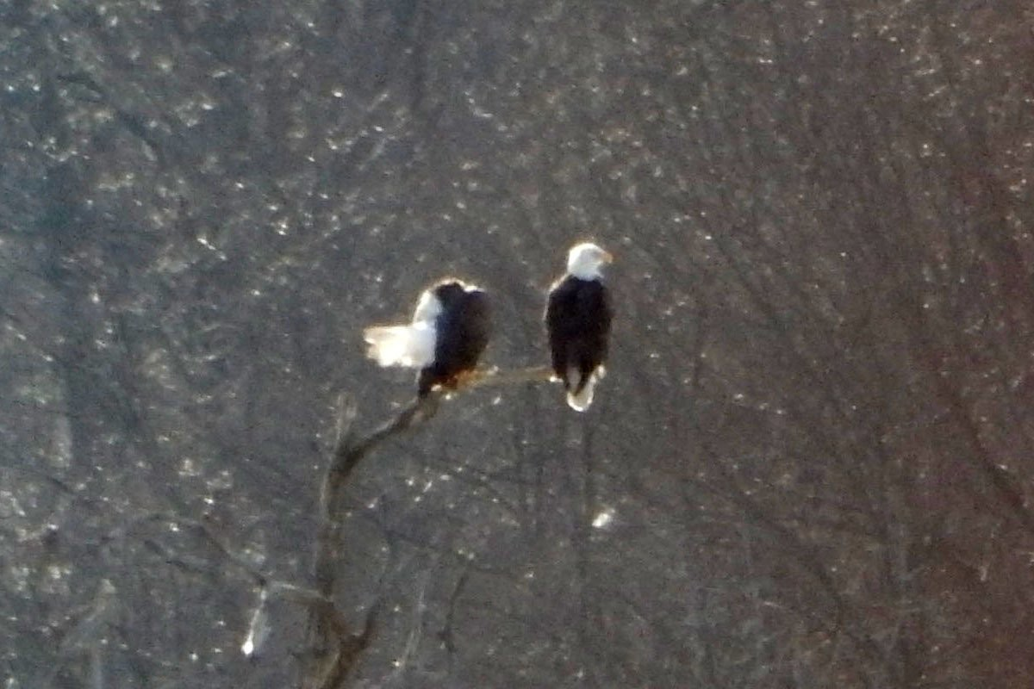
February 17, 2019 (3:19 PM): Love Birds 3

Slide 23
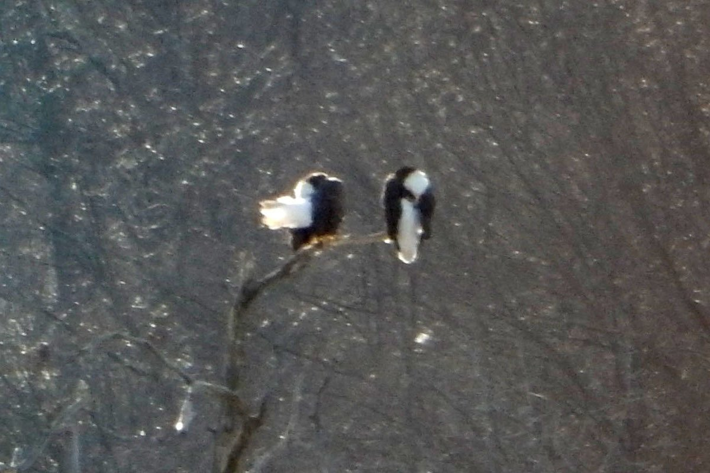
February 17, 2019 (3:19 PM): Love Birds 4

Slide 24
How to Make an Eagle
Mohansic Lake - FDR State Park Yorktown, NY
February 26 to April 12, 2019:
Sitting on the Eggs (22 photos)

Slide 25
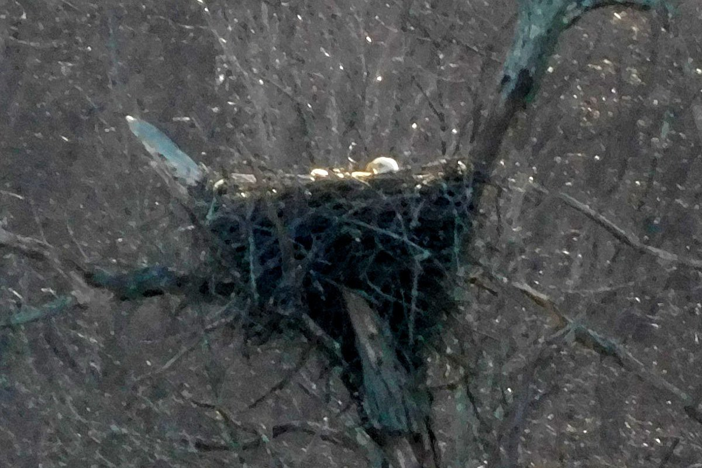
February 26, 2019:
One Adult Eagle Sitting Deep in the Nest

Slide 26
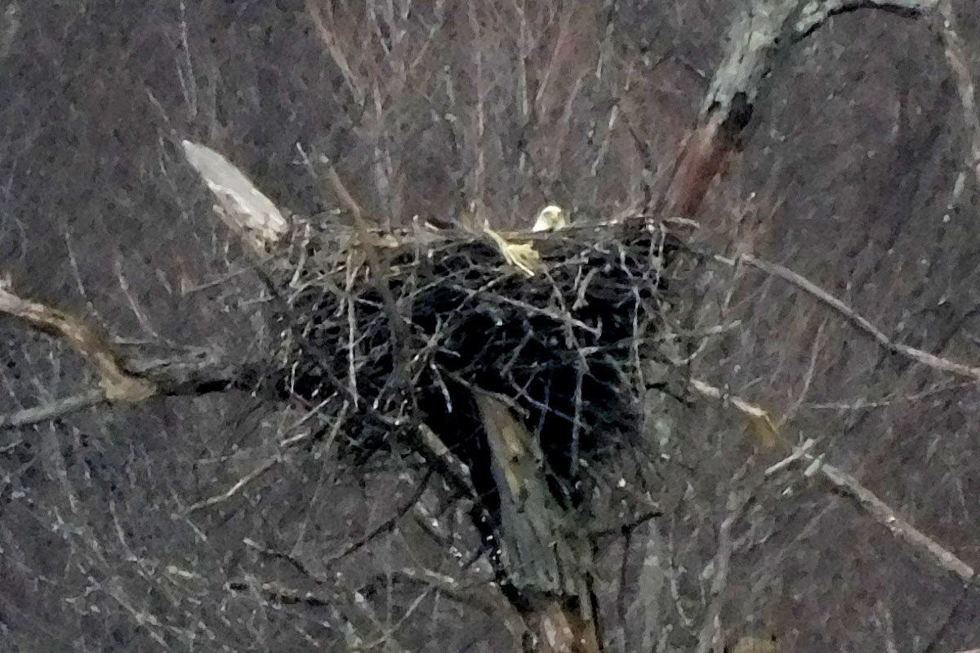
March 3, 2019: An Adult Eagle Sitting Deep in the Nest

Slide 27
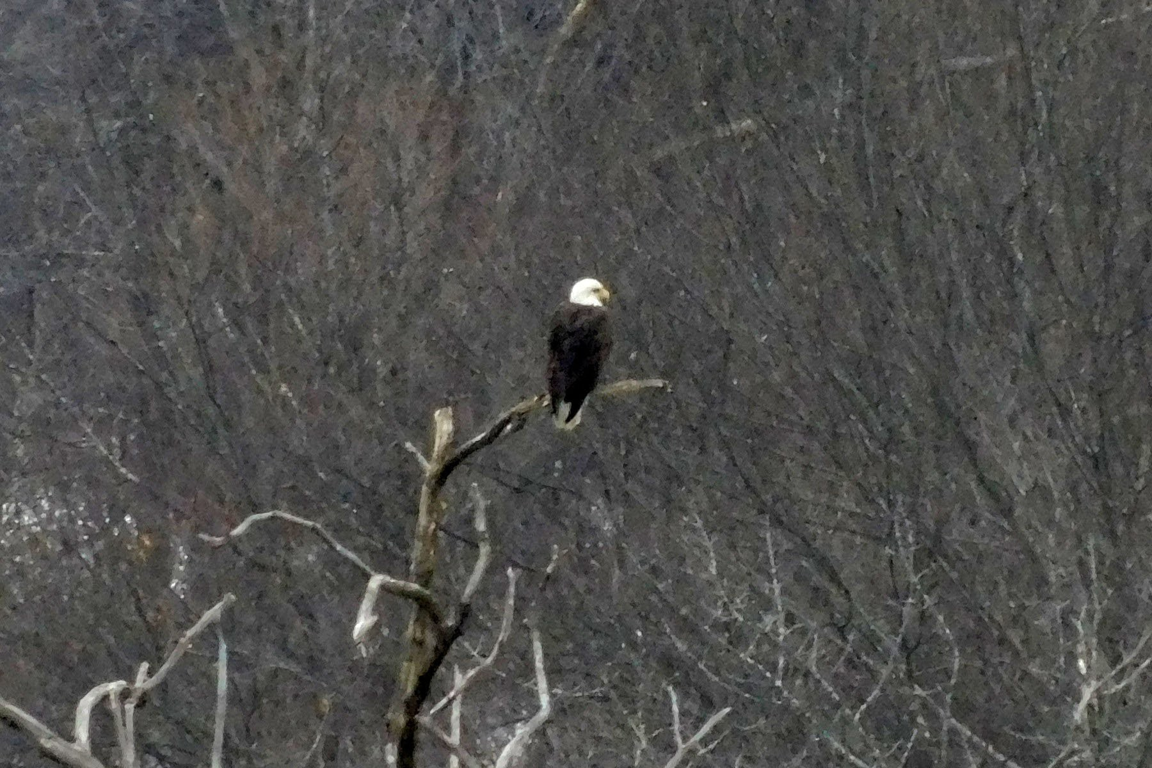
March 3, 2019: An Adult Eagle Perched on a Tree

Slide 28
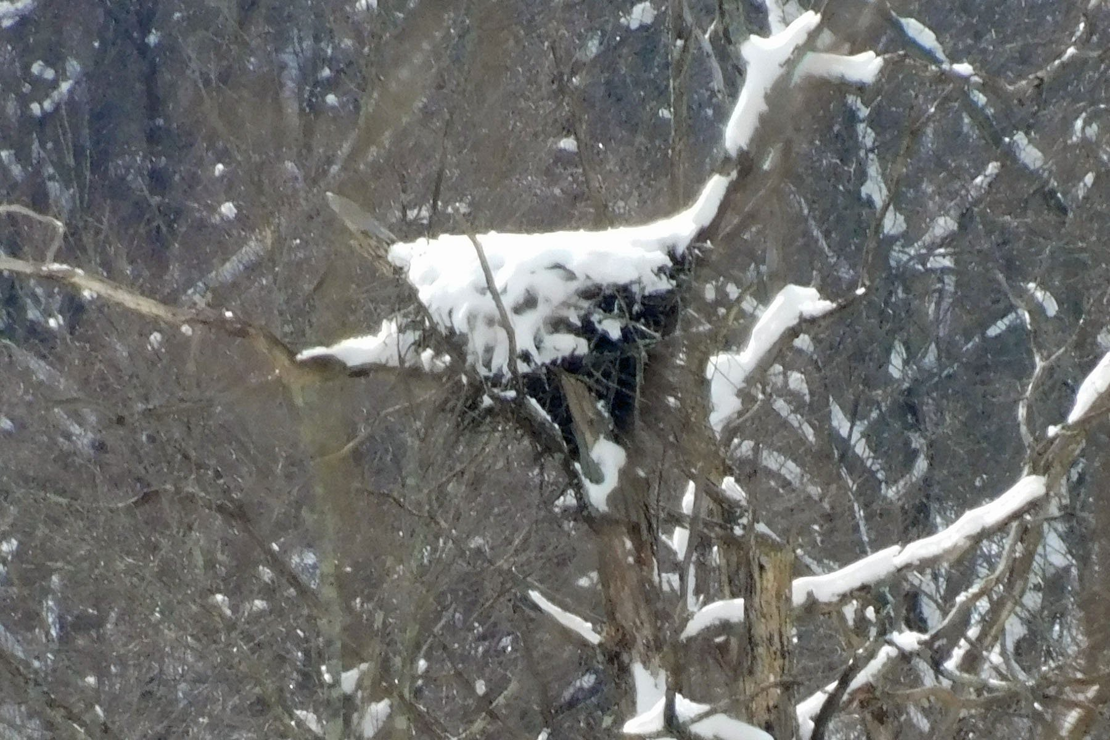
March 4, 2019: Snow Covered Nest 1

Slide 29
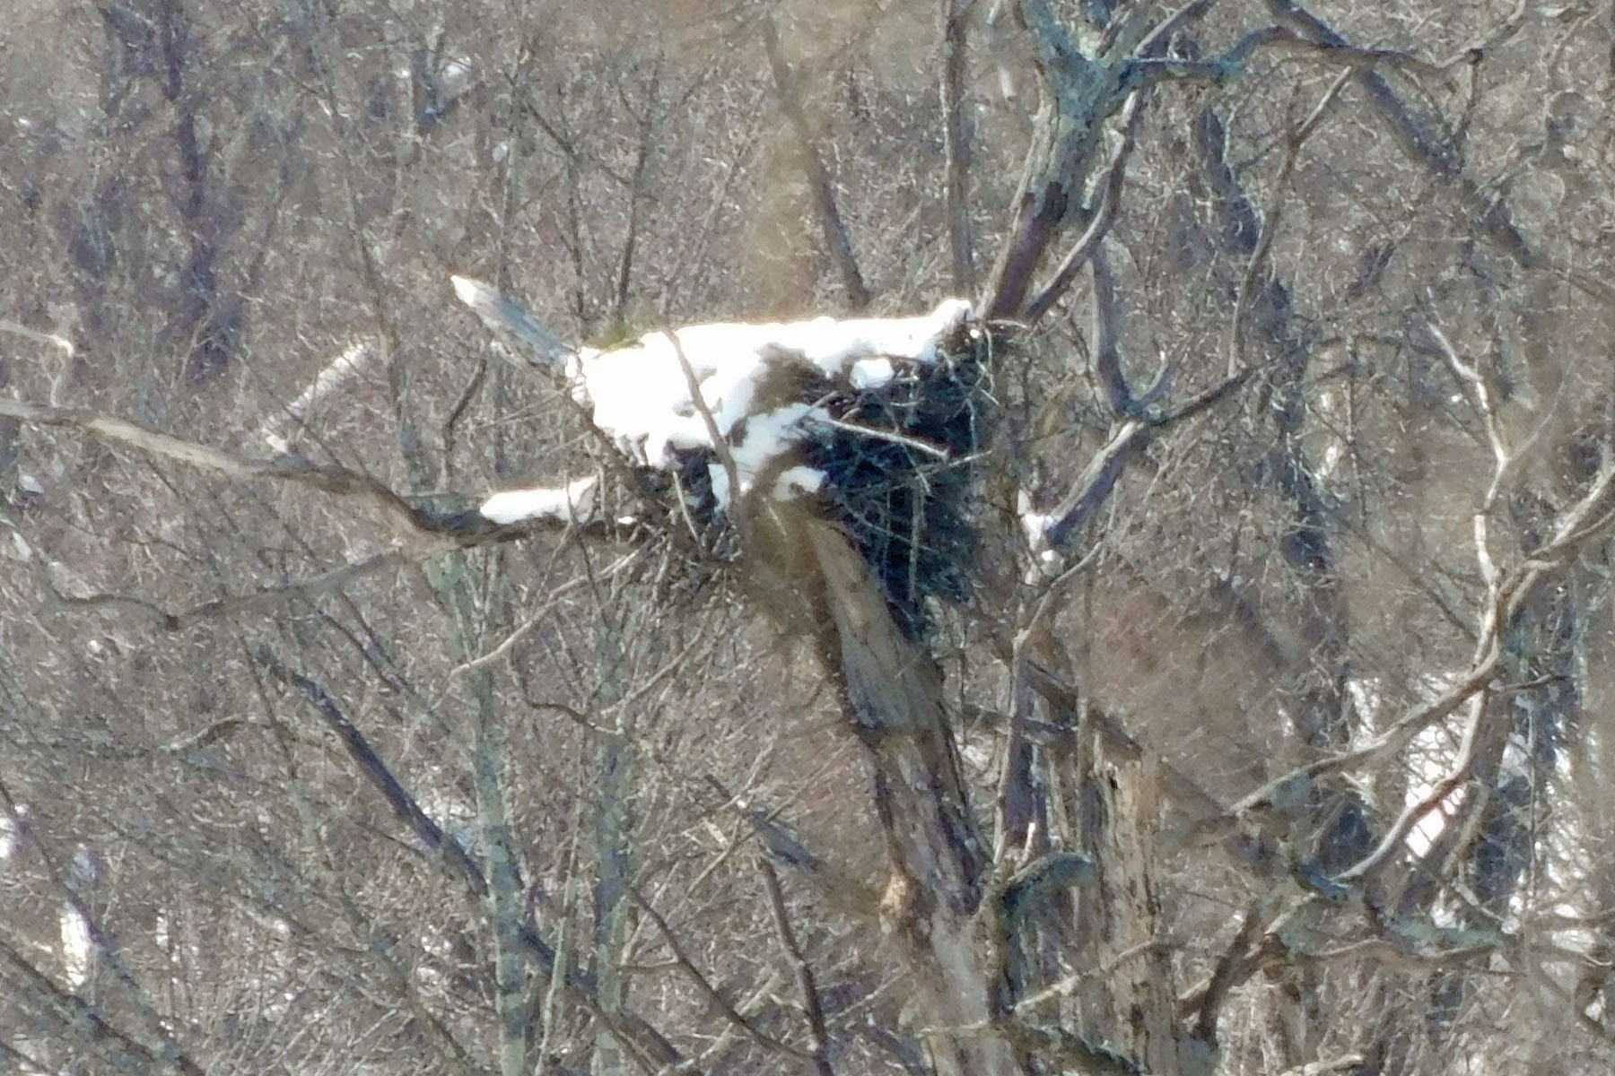
March 5, 2019: Snow Covered Nest 2

Slide 30
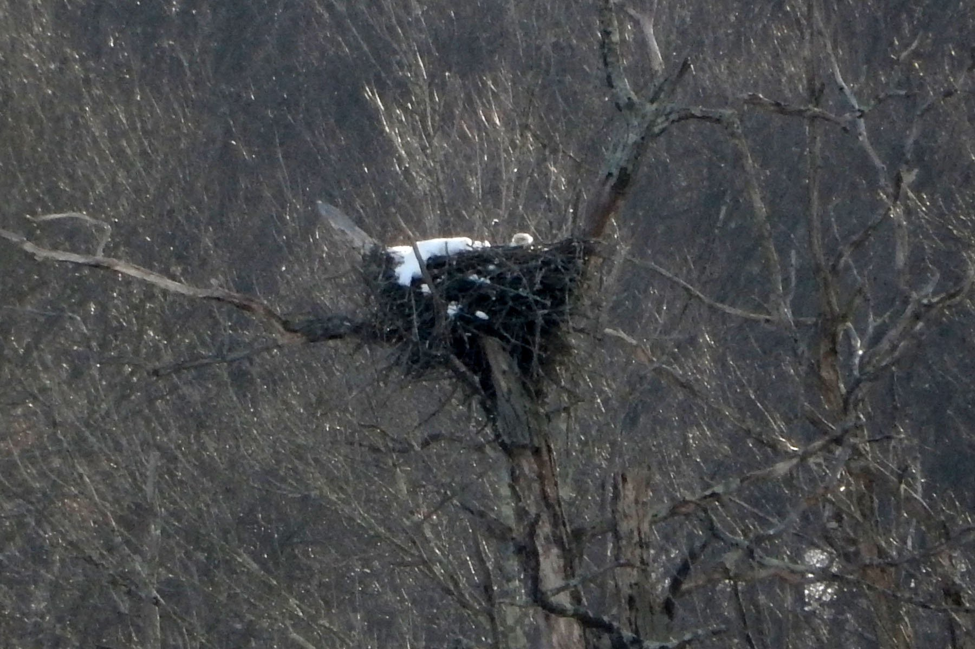
March 6, 2019: Snow Covered Nest 3

Slide 31
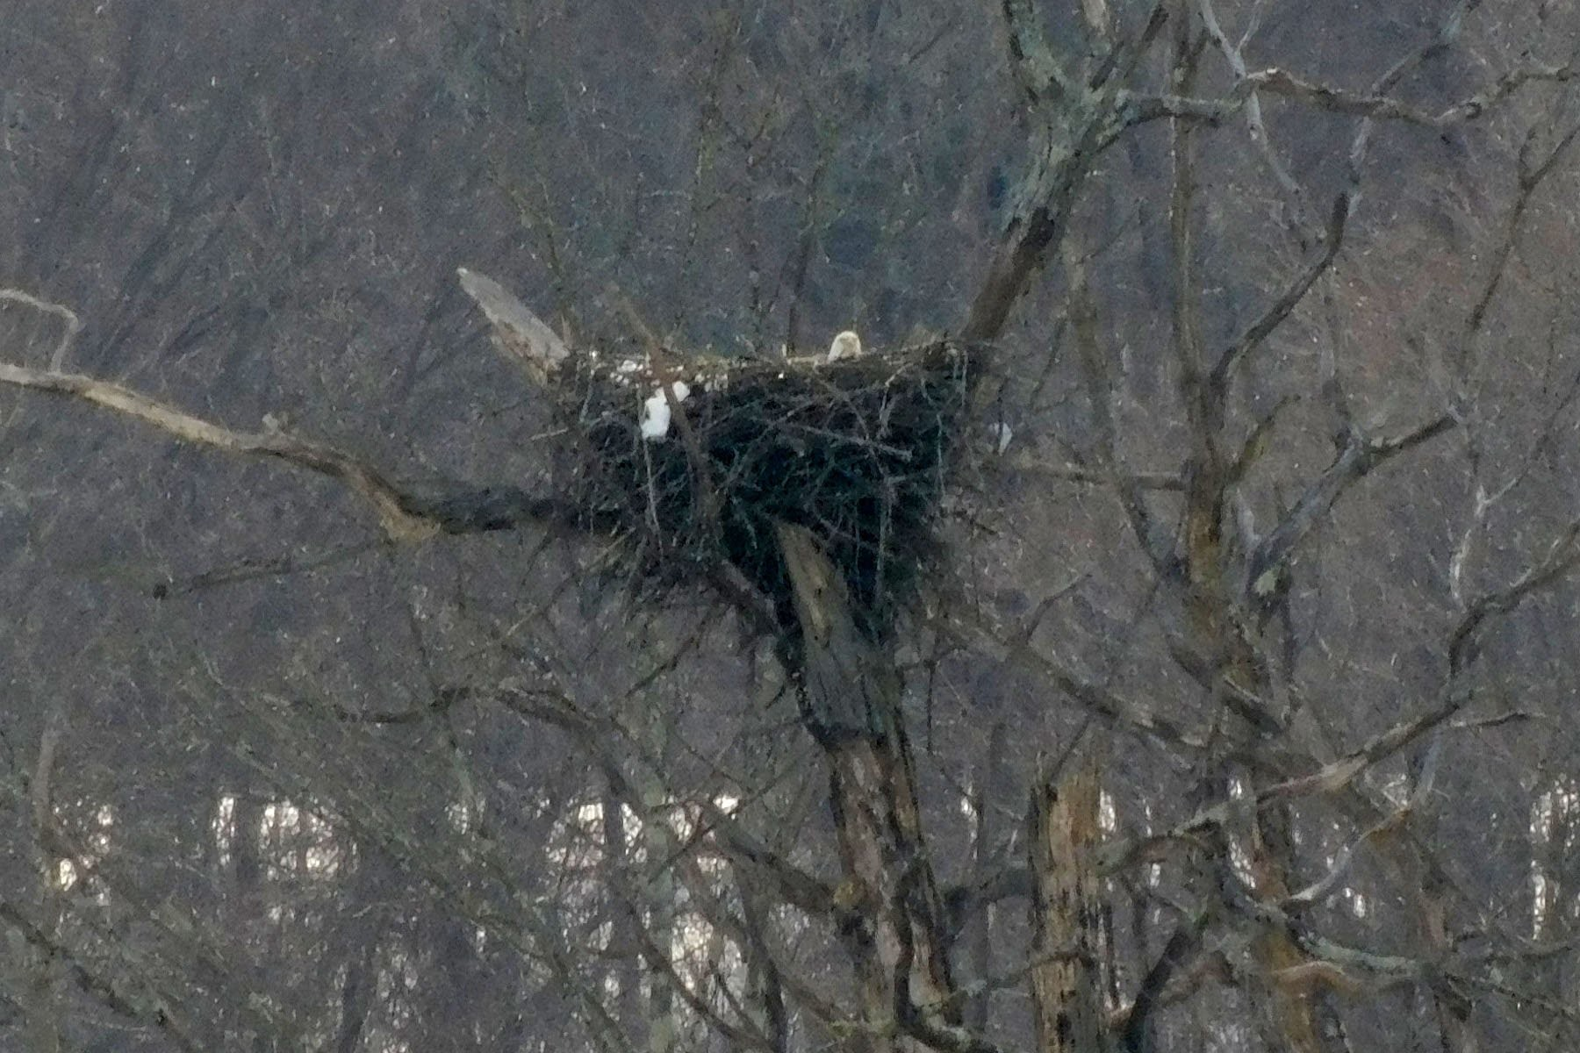
March 8, 2019: Snow Covered Nest 4

Slide 32
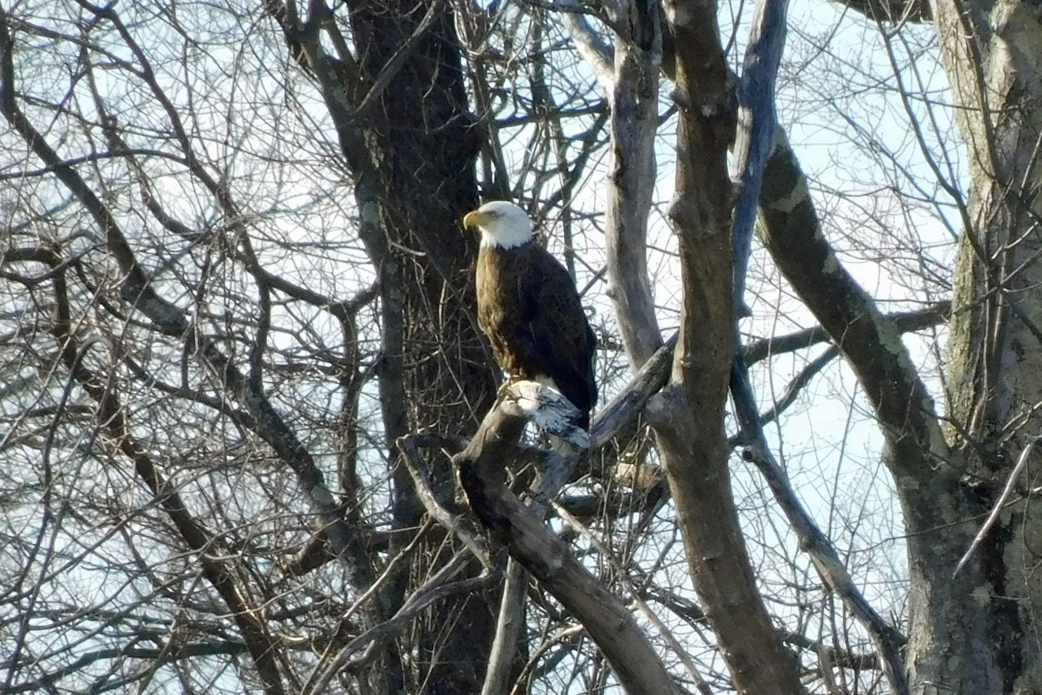
March 12, 2019:
One Adult Eagle on the Near Side of Mohansic Lake

Slide 33
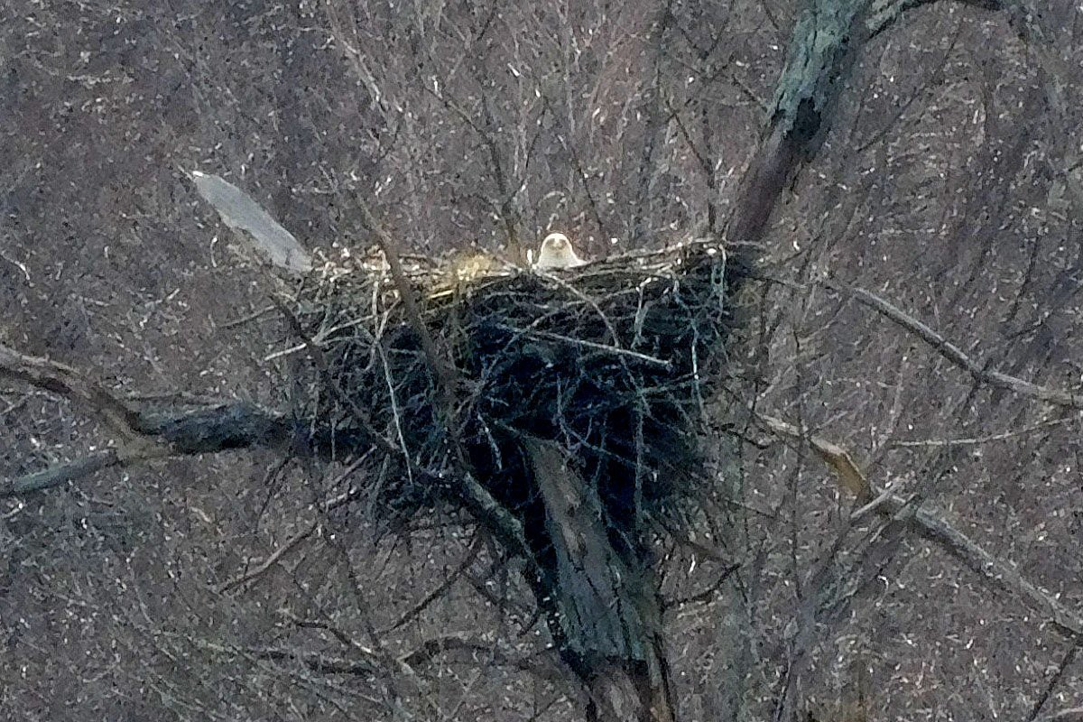
March 25, 2019: One Adult Eagle Watching the Camera

Slide 34
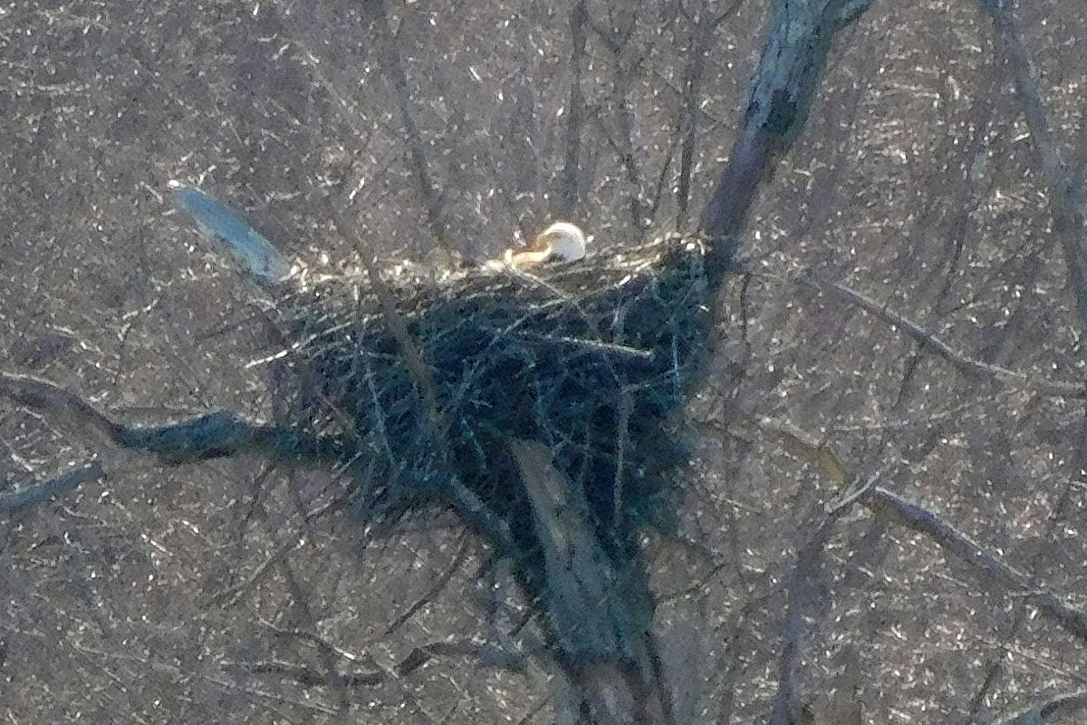
March 26, 2019: One Adult Eagle Resting Low in the Nest

Slide 35
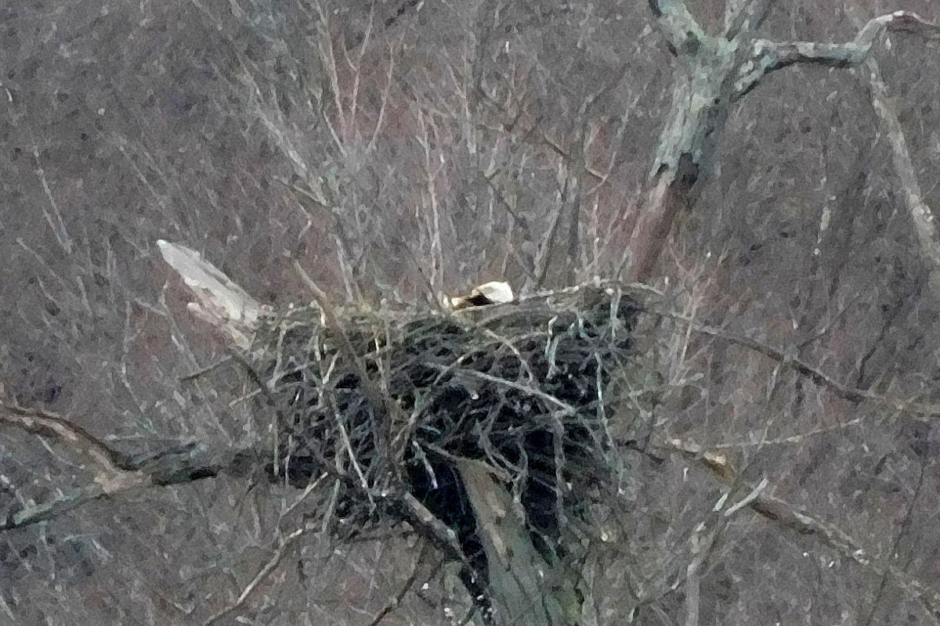
March 31, 2019: One Adult Eagle Resting Low in the Nest

Slide 36
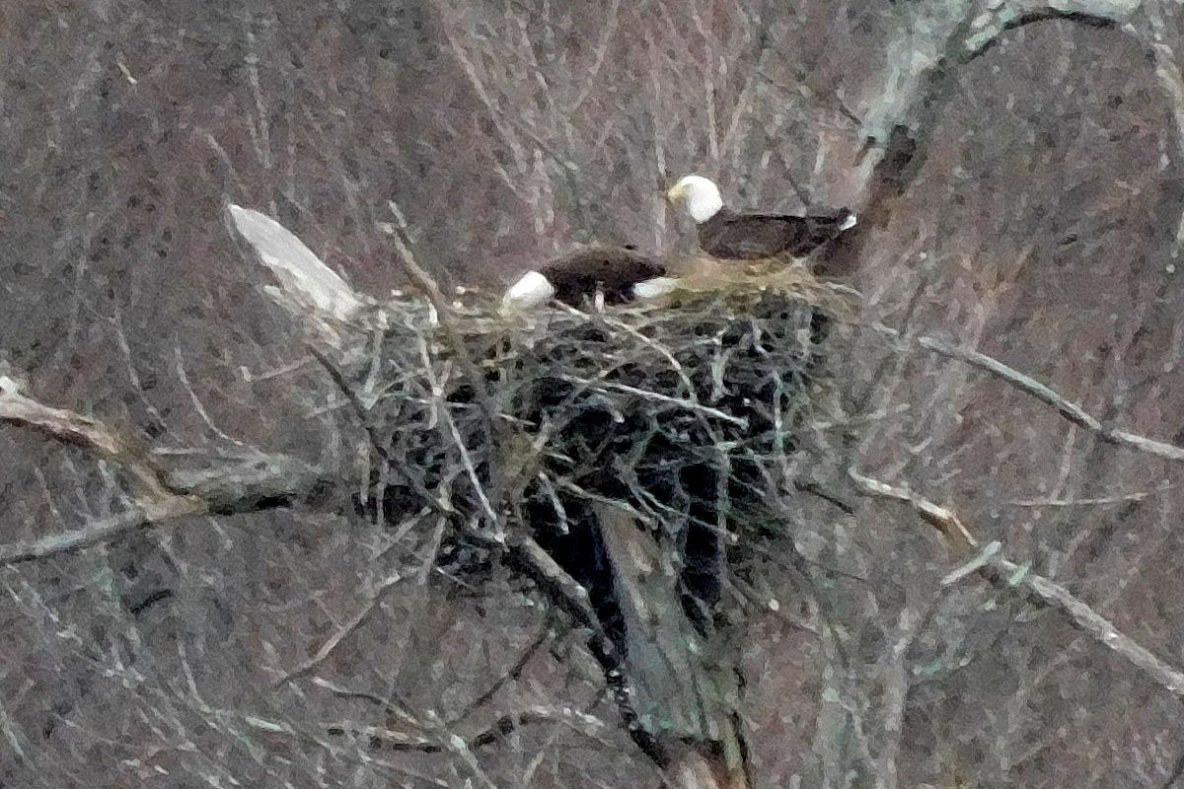
April 2, 2019: Two Adult Eagles on the Nest

Slide 37
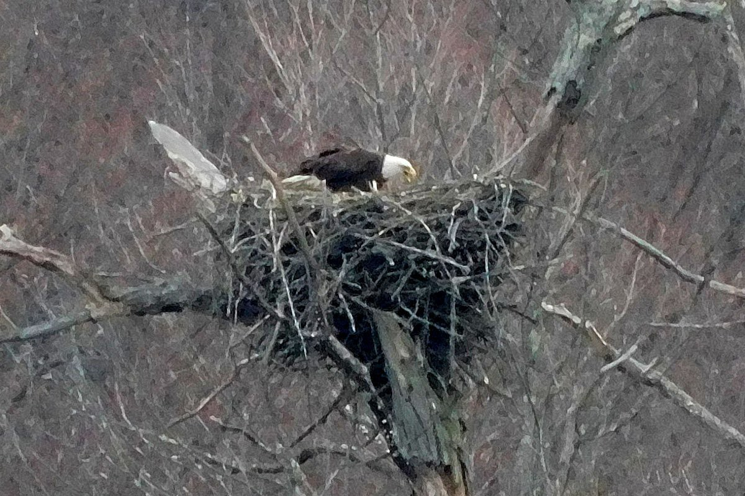
April 7, 2019:
One Adult Eagle on the Nest with its Beak Open

Slide 38
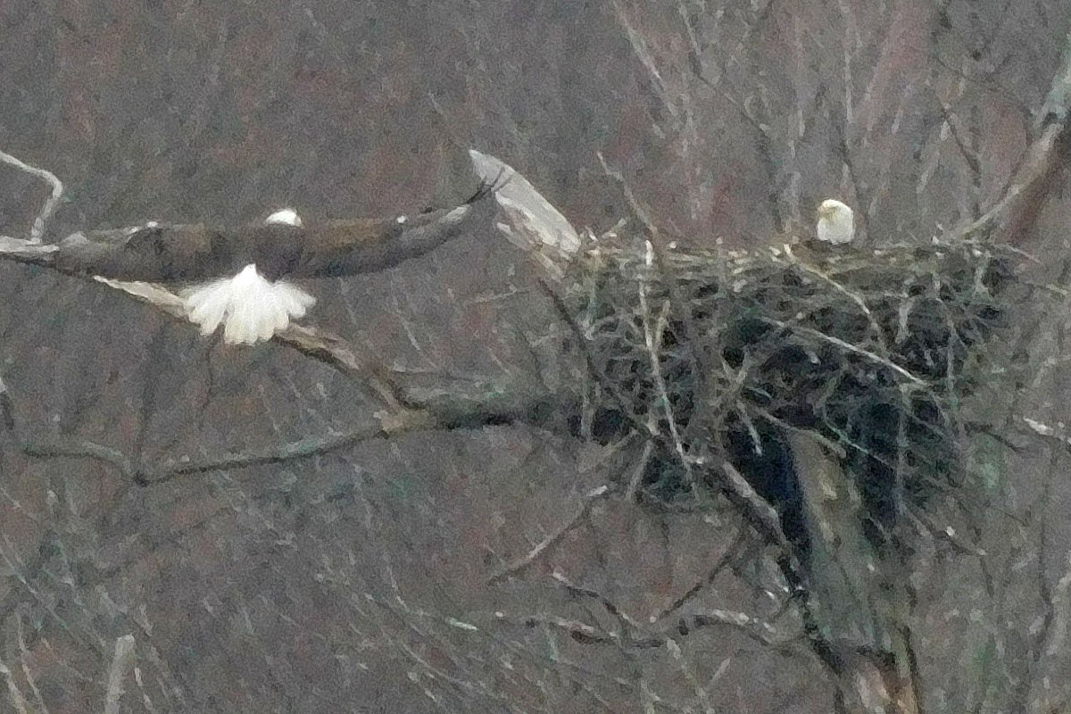
April 9, 2019: Second Adult Eagle Arriving at the Nest

Slide 39
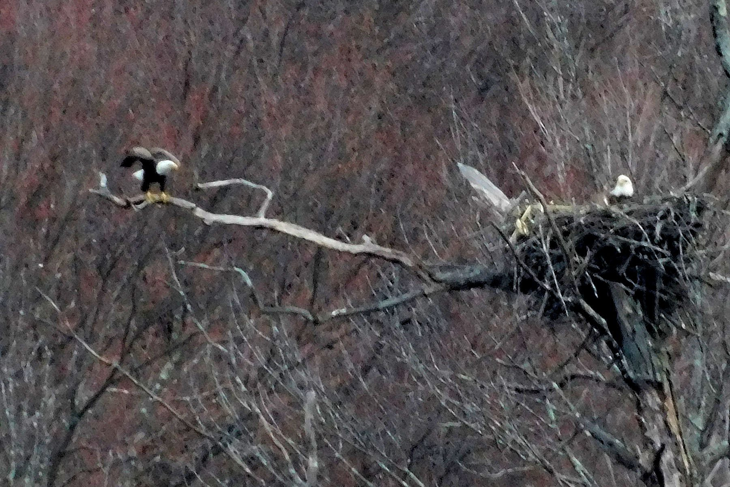
April 11, 2019 (5:19 PM):
One Adult Eagle Ready to Take Off

Slide 40
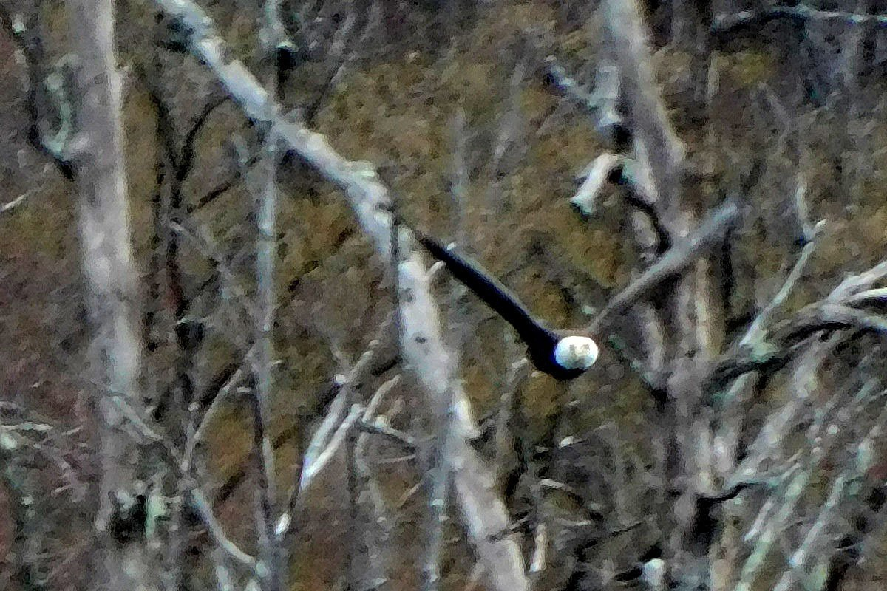
April 11, 2019 (5:20 PM): One Adult Eagle in Flight

Slide 41
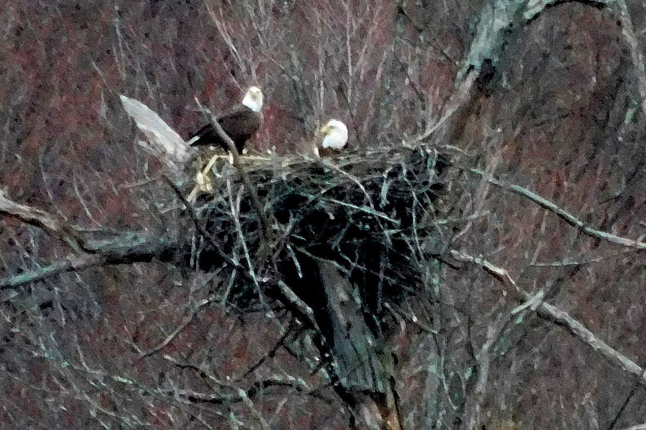
April 11, 2019 (5:26 PM):
Two Adult Eagles, One on the Nest and One in the Nest

Slide 42
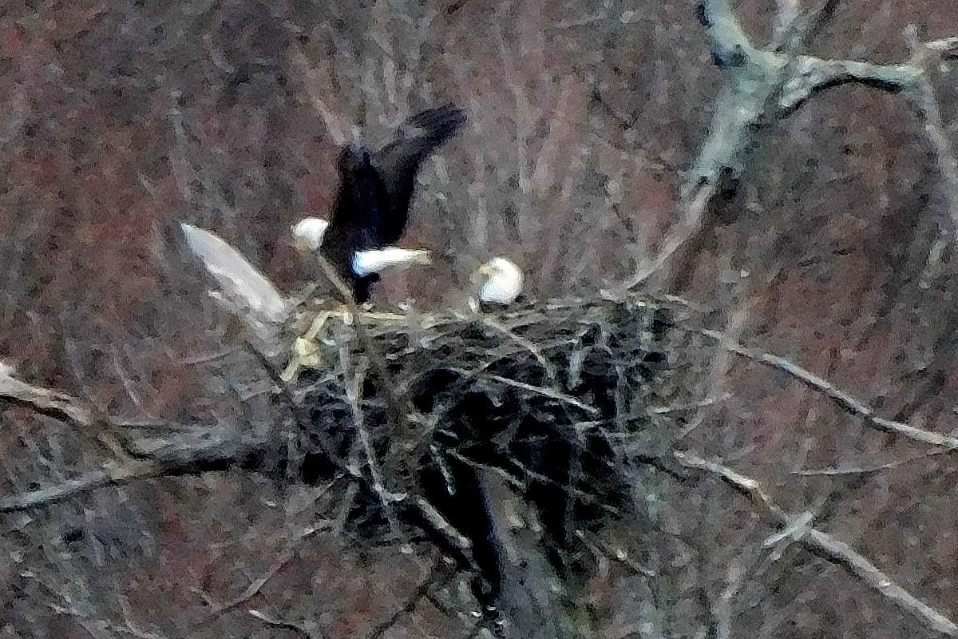
April 11, 2019 (5:26 PM):
Two Adult Eagles, One on the Nest and One in the Nest

Slide 43
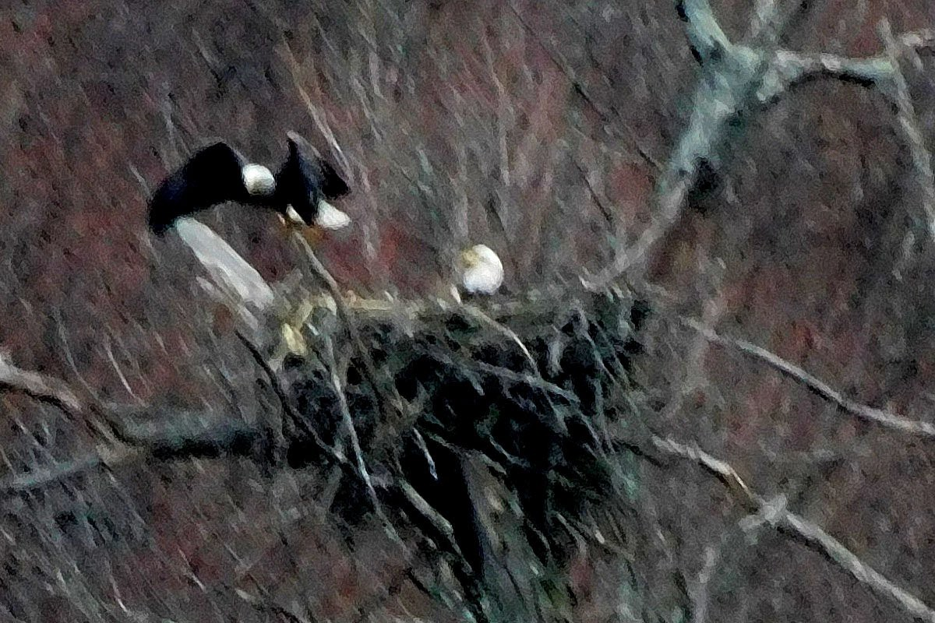
April 11, 2019 (5:26 PM): Two Adult Eagles, One in the Nest and One Leaving the Nest

Slide 44
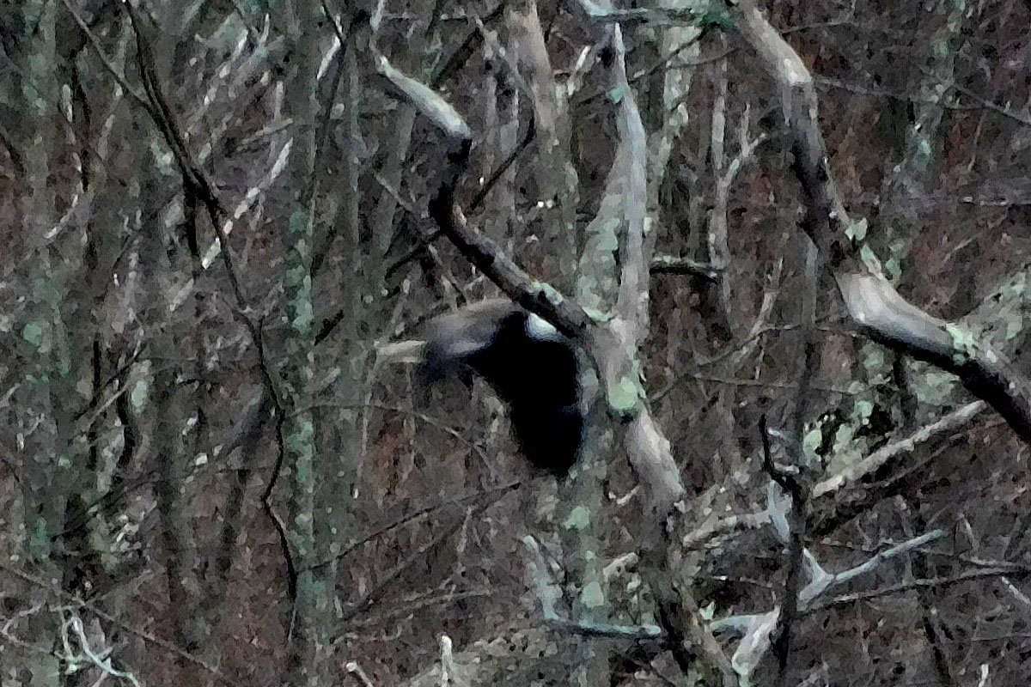
April 11, 2019 (5:27 PM): Adult Eagle in Flight

Slide 45
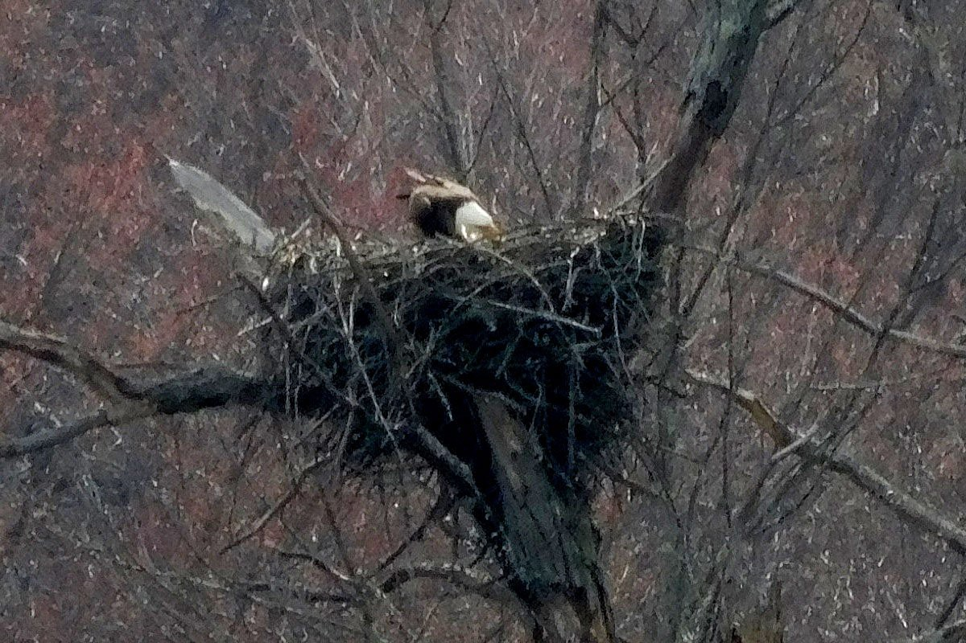
April 12, 2019 (3:42 PM):
One Adult Eagle Looking into the Nest

Slide 46
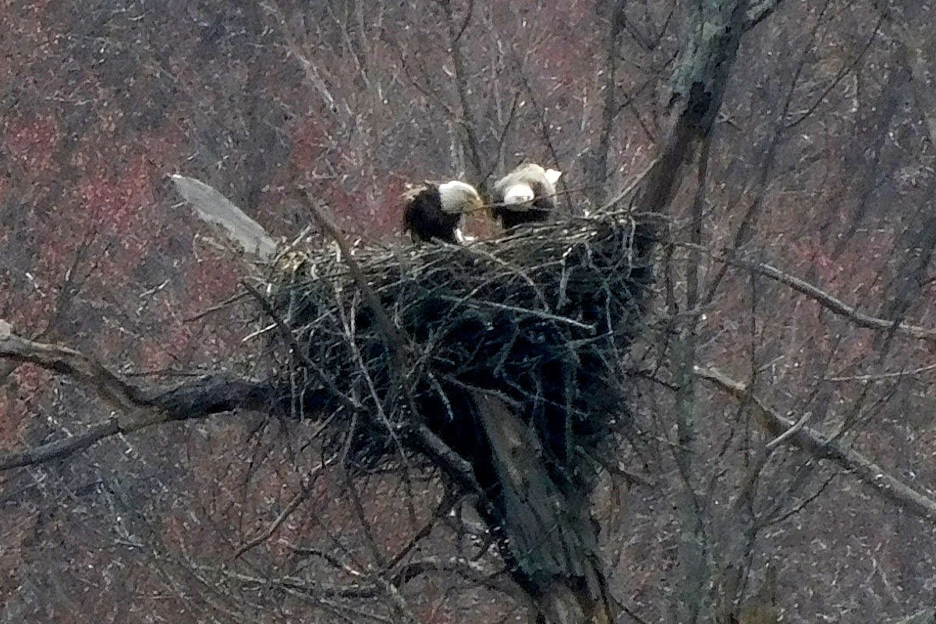
April 12, 2019 (3:42 PM):
Two Adult Eagles Building the Nest

Slide 47
How to Make an Eagle
Mohansic Lake - FDR State Park Yorktown, NY
April 15 to April 30, 2019:
Down-covered Baby Eaglets
(16 photos)

Slide 48
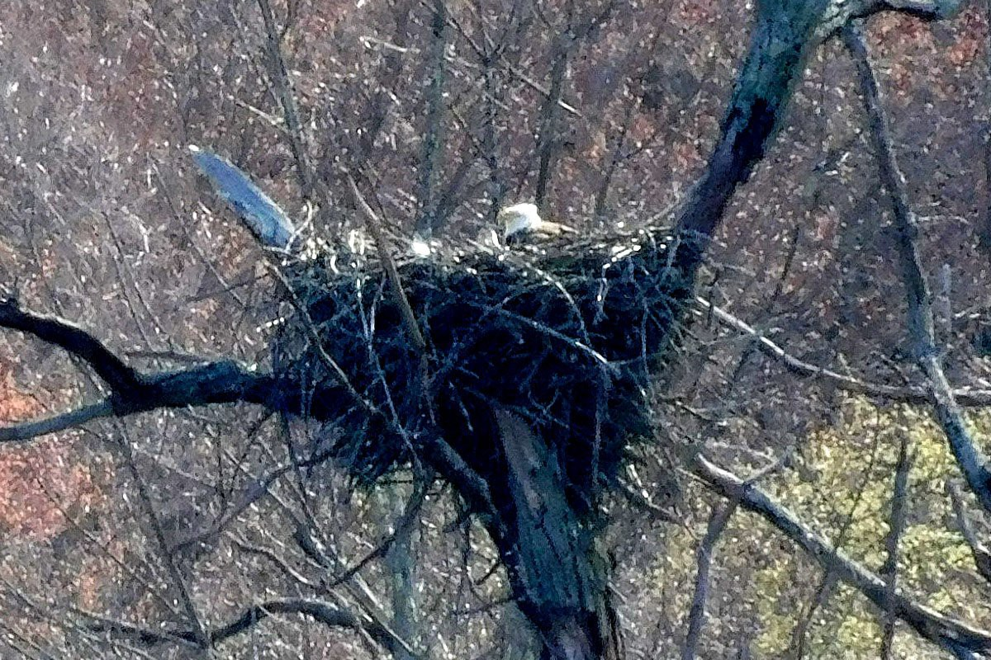
April 15, 2019: One Adult Eagle in the Nest with a New Hatchling Baby Eaglet

Slide 49
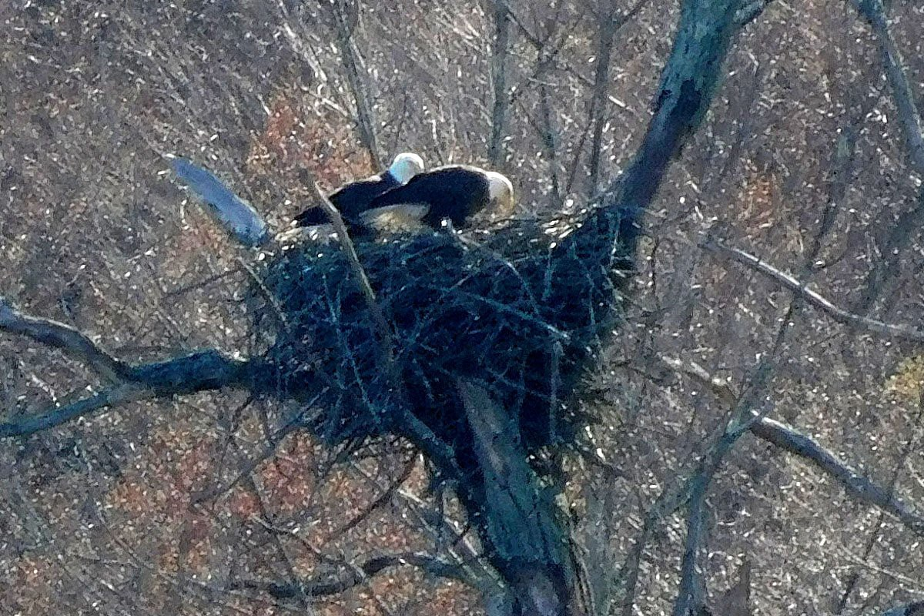
April 16, 2019 (4:53 PM): Two Adult Eagles on the Nest

Slide 50
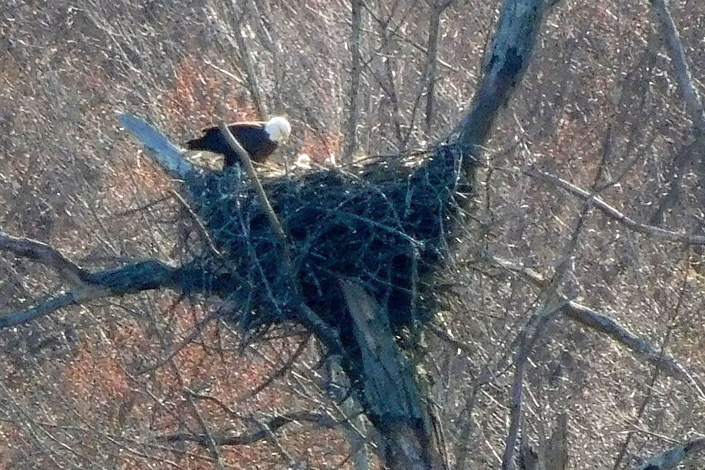
April 16, 2019 (5:03 PM): One Adult Eagle on the Nest and One Baby Eaglet in the Nest

Slide 51
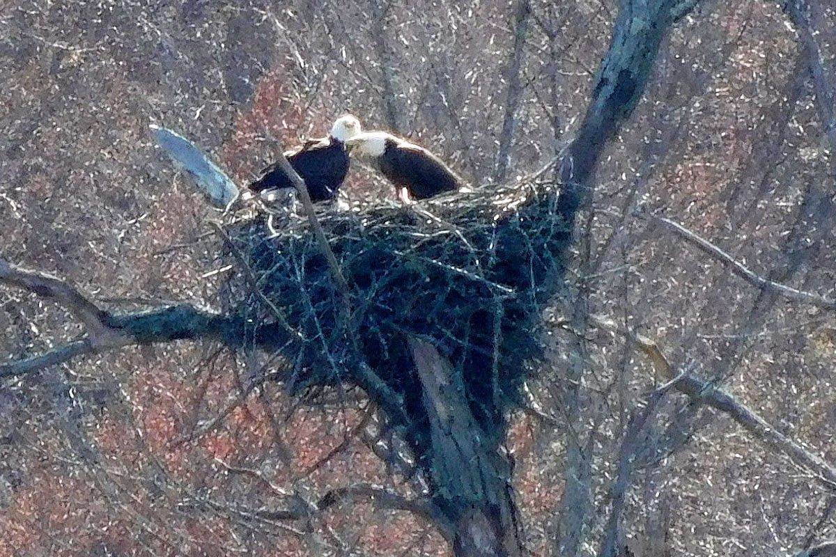
April 17, 2019 (3:50 PM): Two Adult Eagles on the Nest

Slide 52
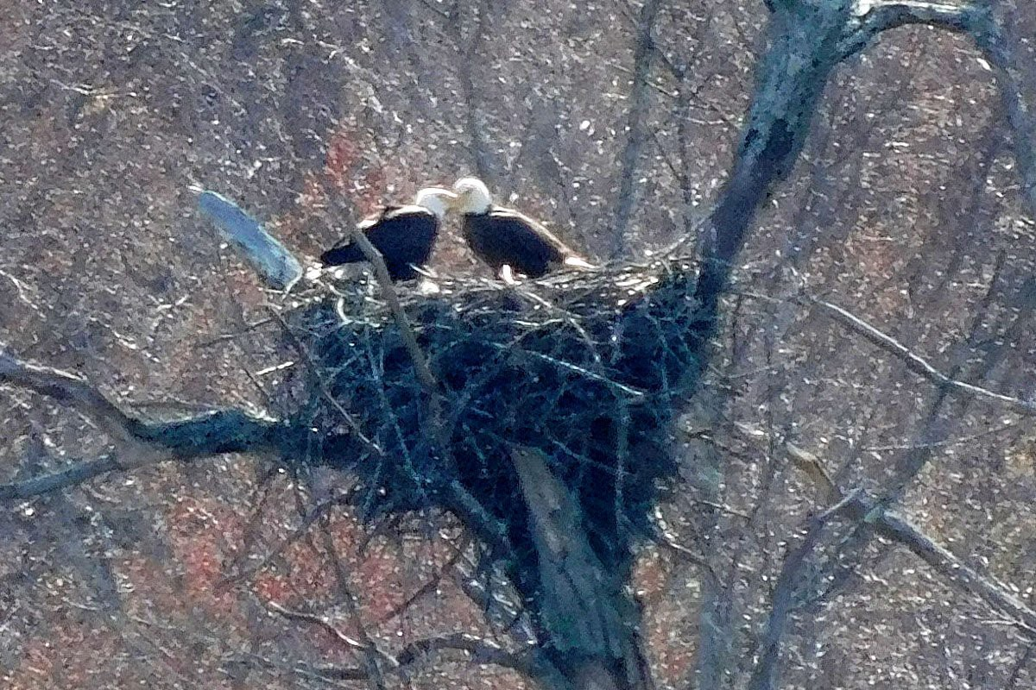
April 17, 2019 (3:50 PM): Two Adult Eagles on the Nest

Slide 53
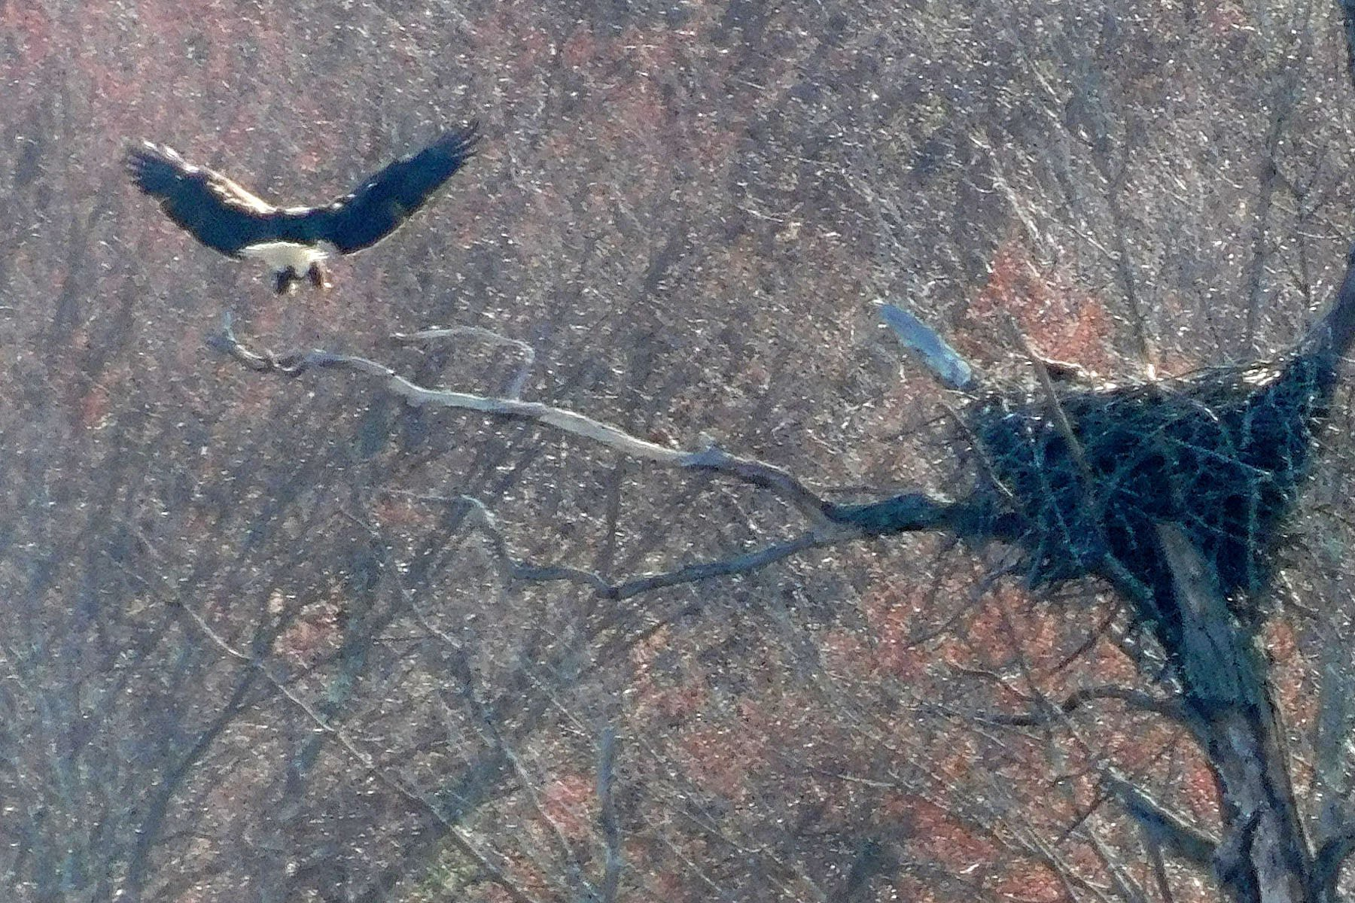
April 17, 2019 (4:47 PM):
One Adult Eagle Landing on the Branch

Slide 54
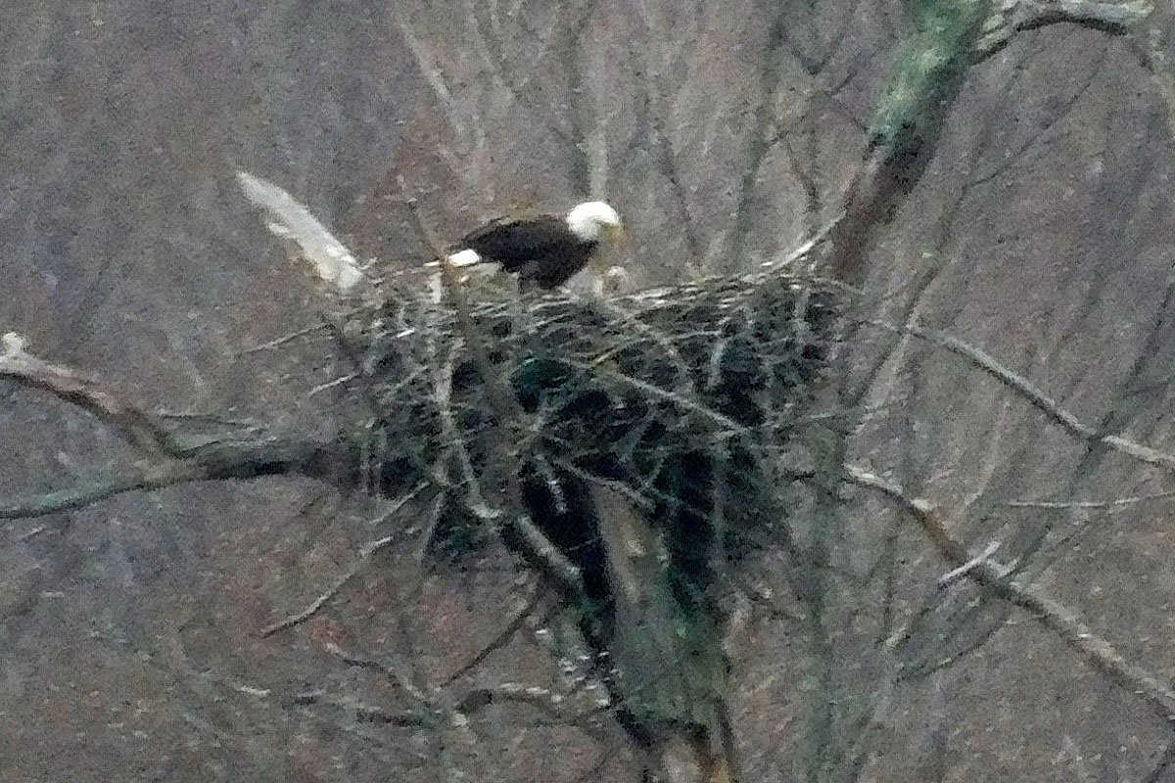
April 18, 2019 (5:19 PM):
One Adult Eagle with a Hatchling Baby Eaglet in the Nest

Slide 55

April 18, 2019 (5:36 PM):
One Adult Eagle with a Hatchling Baby Eaglet in the Nest

Slide 56

April 19, 2019 (2:52 PM): One Adult Eagle on the Nest with a Hatchling Baby Eaglet in the Nest

Slide 57

April 19, 2019 (2:54 PM): One Adult Eagle on the Nest with One Hatchling Baby Eaglet in the Nest

Slide 58

April 19, 2019 (2:54 PM): One Adult Eagle on the Nest with One Baby Eaglet in the Nest

Slide 59

April 23, 2019: One Adult Eagle on the Nest with Two Baby Eaglets in the Nest

Slide 60

April 26, 2019: An Adult Eagle Shows Affection to Two Baby Eaglets in the Nest

Slide 61

April 28, 2019: One Adult Eagle on the Nest with Two Baby Eaglets in the Nest

Slide 62

April 30, 2019 (4:41 PM): One Adult Eagle on the Nest with Two Baby Eaglets in the Nest

Slide 63

April 30, 2019 (4:43 PM): One Adult Eagle on the Nest with Two Baby Eaglets in the Nest

Slide 64
How to Make an Eagle
Mohansic Lake - FDR State Park Yorktown, NY
May 2 to May 29, 2019:
The Eaglets Grow and Develop
(13 photos)

Slide 65

May 2, 2019: One Adult Eagle on the Nest with One Baby Eaglet in the Nest

Slide 66

May 3, 2019: One Adult Eagle on the Nest with Two Baby Eaglets in the Nest

Slide 67

May 4, 2019 (4:05 PM):
Two Baby Eaglets Alone in the Nest

Slide 68

May 4, 2019 (4:12 PM):
One Adult Eagle in the Woods

Slide 69

May 4, 2019 (6:06 PM): One Adult Eagle Outside the Nest and Two Eaglets in the Nest

Slide 70

May 14, 2019: One Adult Eagle and Two Eaglets

Slide 71

May 16, 2019: Two Eaglets Alone in the Nest

Slide 72

May 22, 2019: Two Eaglets Alone in the Nest

Slide 73

May 24, 2019:
One Adult Eagle and Two Eaglets in the Nest.

Slide 74

May 27, 2019 (7:07 PM): Two Eaglets Alone in the Nest, One with Its Wings Open

Slide 75

May 27, 2019 (7:09 PM):
Two Adult Eagles Perched on a Tree

Slide 76

May 28, 2019: One Eaglet Alone in the Nest

Slide 77

May 29, 2019: Four Eagles in the Nest

Slide 78
How to Make an Eagle
Mohansic Lake - FDR State Park Yorktown, NY
June 1 to August 1, 2019:
The Eaglets Learn to Fly
(23 photos)

Slide 79

June 1, 2019 (7:01 PM):
Two Adult Eagles, One Taking Off

Slide 80

June 1, 2019 (7:01 PM): Adult Eagle About to Land

Slide 81

June 1, 2019 (7:02 PM):
Two Eaglets Alone in the Nest, One with Wings Open

Slide 82

June 2, 2019 (6:24 PM):
Eaglet with Wings Spread Wide Open

Slide 83

June 2, 2019 (6:24 PM):
Eaglet with Wings Spread Wide Open

Slide 84

June 12, 2019 (4:27 PM):
Eaglet with Two Feet in the Air

Slide 85

June 12, 2019 (4:27 PM):
Eaglet with Wings Spread Wide Open

Slide 86

June 12, 2019 (4:29 PM):
Eaglet with Wings Spread Wide Open

Slide 87

June 13, 2019: One Adult Eagle and Two Eaglets

Slide 88

June 17, 2019: Two Eaglets Alone in the Nest

Slide 89

June 18, 2019: One Eaglet Perched Over the Nest

Slide 90

June 20, 2019: Two Eaglets in Haze

Slide 91

June 24, 2019: Both Eaglets Out of the Nest

Slide 92

June 26, 2019: Eaglet with Wings Up

Slide 93

June 29, 2019: Two Eaglets Out of the Nest

Slide 94

June 30, 2019: Two Eaglets Out of the Nest

Slide 95

July 8, 2019:
Eaglet with Wings Open on the Left Branch

Slide 96

July 9, 2019 (7:21 PM):
One Adult Eagle on Mohansic Lake

Slide 97

July 9, 2019 (7:41 PM):
One Adult Eagle on Mohansic Lake

Slide 98

July 12, 2019:
One Juvenile Eagle Landing on the Left Branch

Slide 99

July 20, 2019: One Eaglet and One Adult Eagle

Slide 100

July 28, 2019: One Adult Eagle Perched in a Tree

Slide 101

August 1, 2019:
The Juvenile Eagle on Mohansic Lake

Slide 102
--- The End ---

